Slide 1
33% Hardware Update
Boeing Autonomous
Elise C., Selina C., Jake K., Marek L., Desirae M., Natasa P., Lily Q.

Slide 2
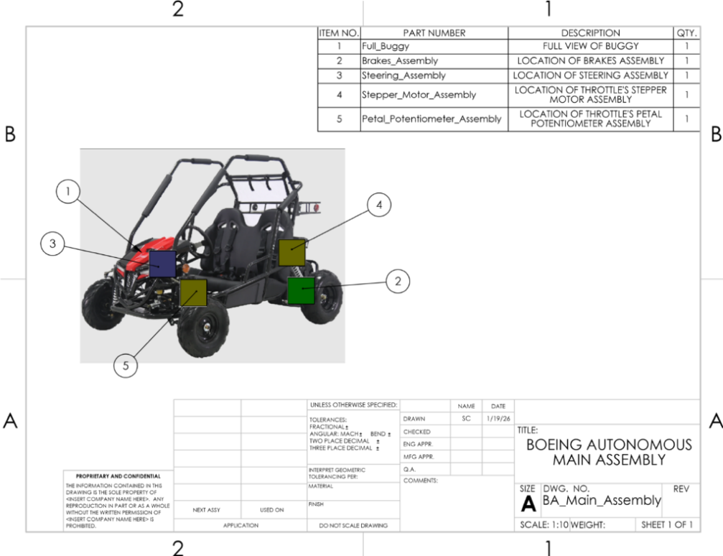
Design Efforts
Main Assembly of Go-Kart

Slide 3
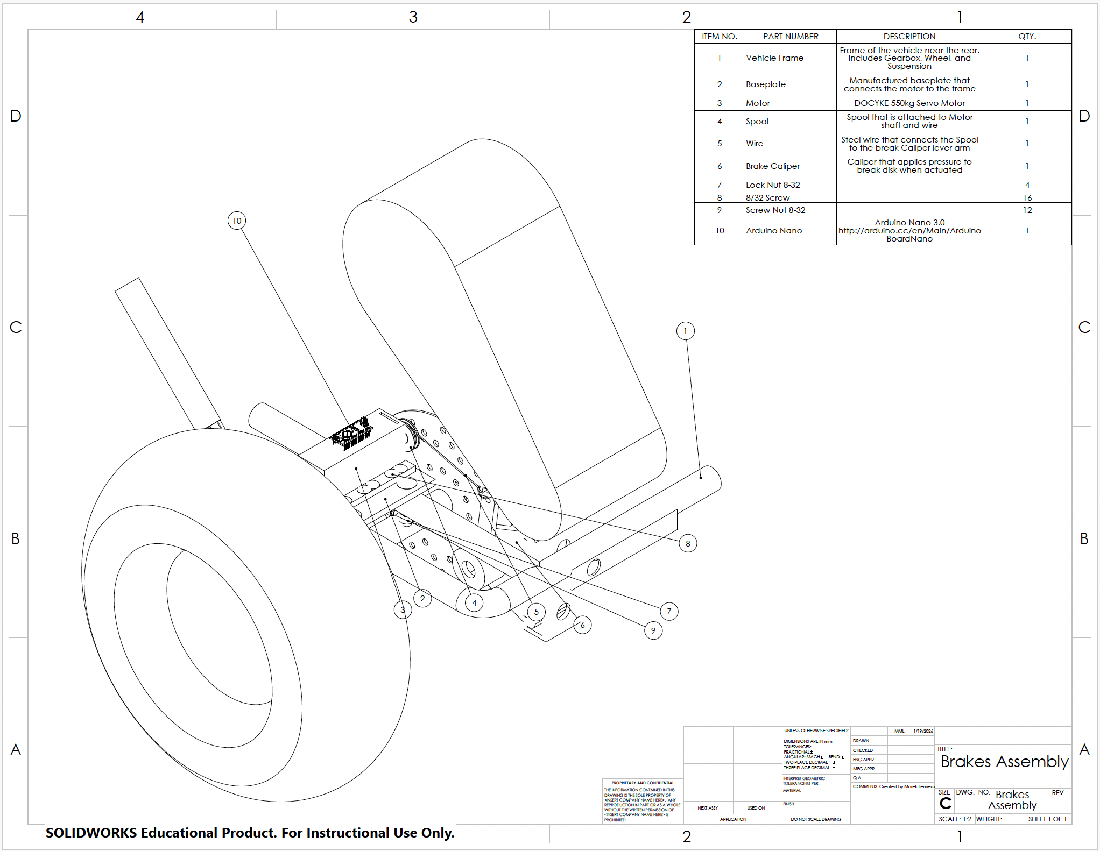
Brakes
Updates
Base plate & caliper bracket: re-manufacture for better precision & fit.
Spool: 3D metal print in progress
Exploring direct motor mounting & caliper arm actuation to drop pull-by-wire.
Calculations Changed
New bracket calculations complete: 3000 N worst-case load.
Overall FoS = 3.2 (calculated from bending in legs, bending at bolt holes, direct shear in legs, and combined weld shear; mainly affected by bending in the legs)
Exceeds target ≥2.5
Brake Assembly
ML & JK 3

Slide 4
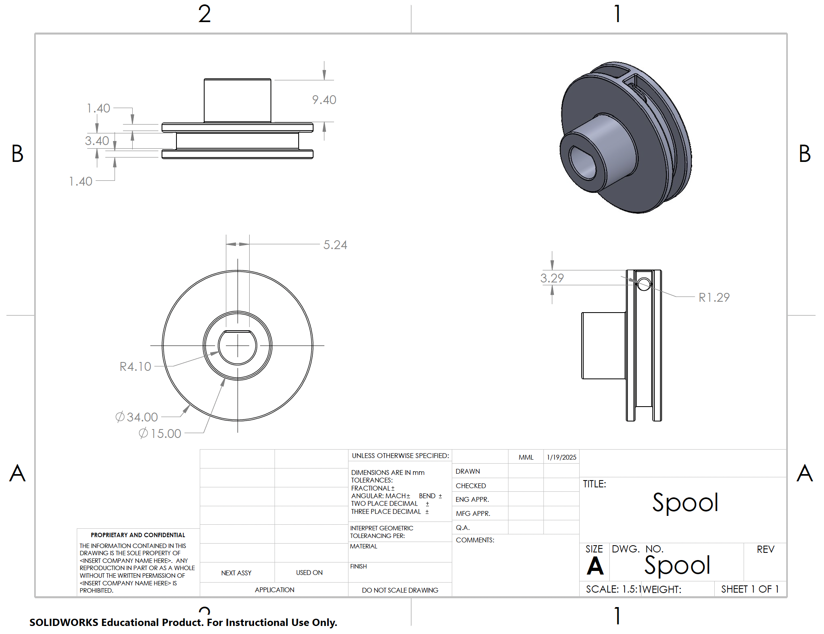
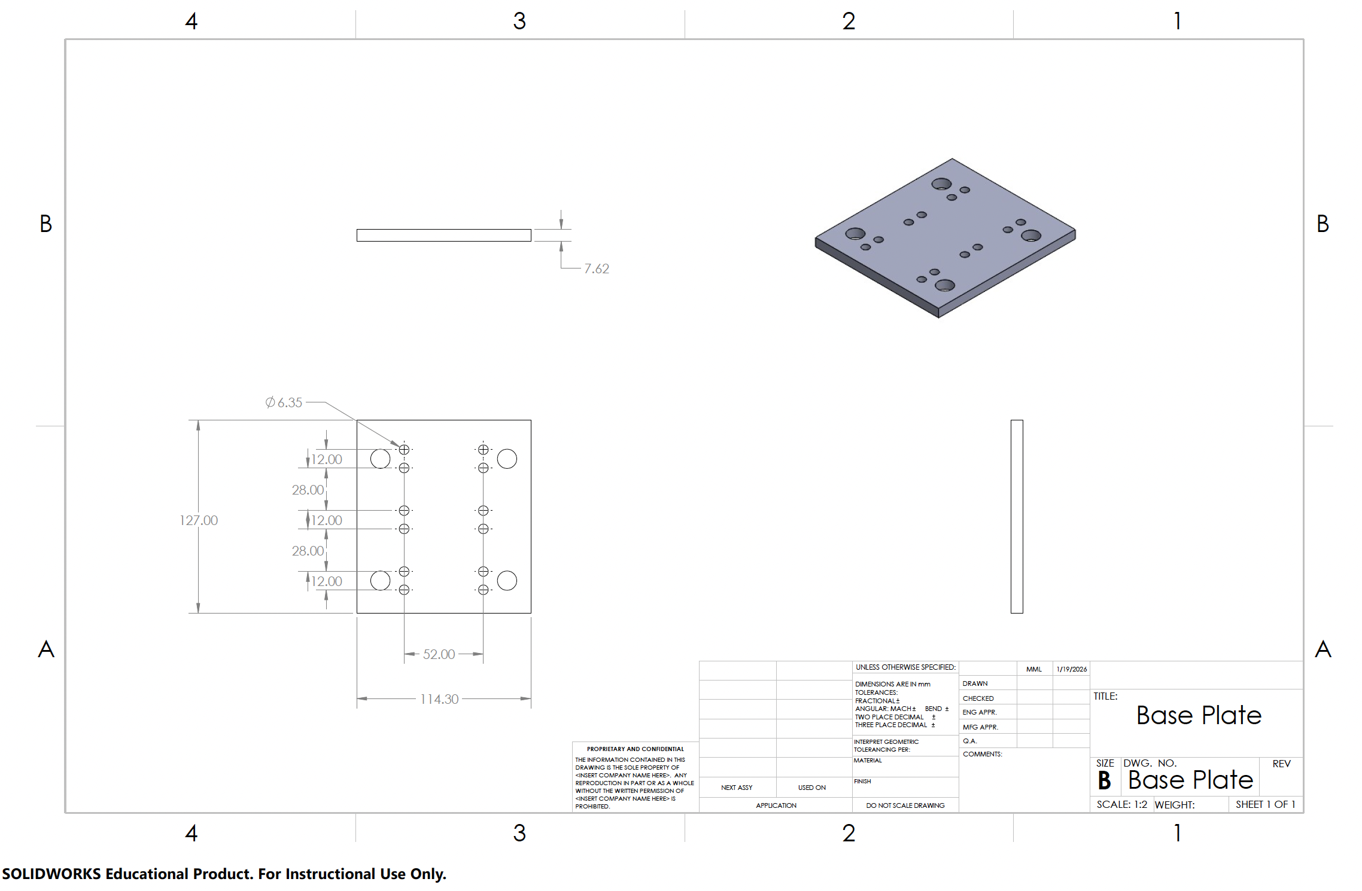
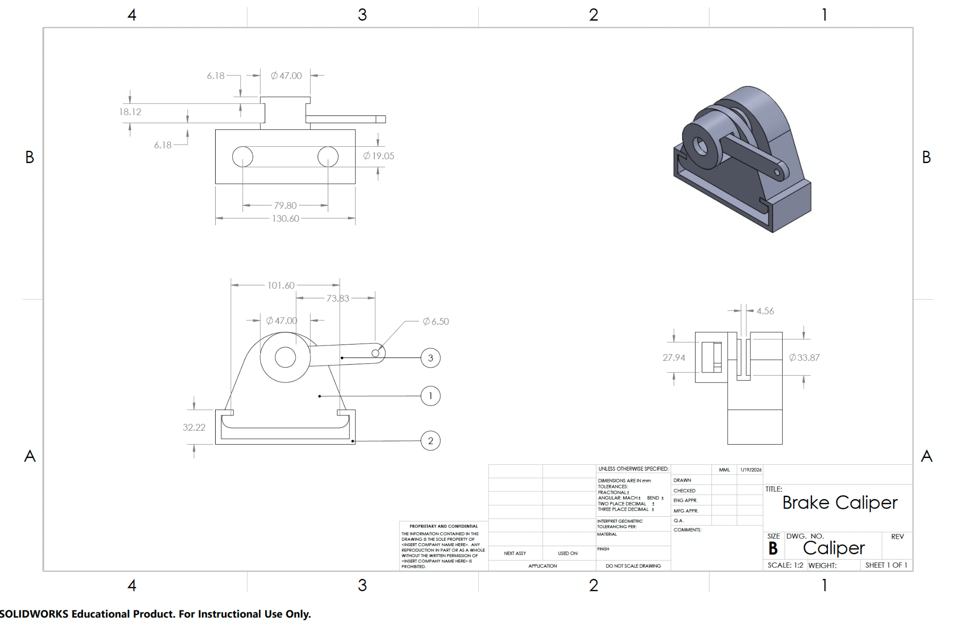
Brakes
Spool
Base Plate
Brake Caliper
ML 4

Slide 5
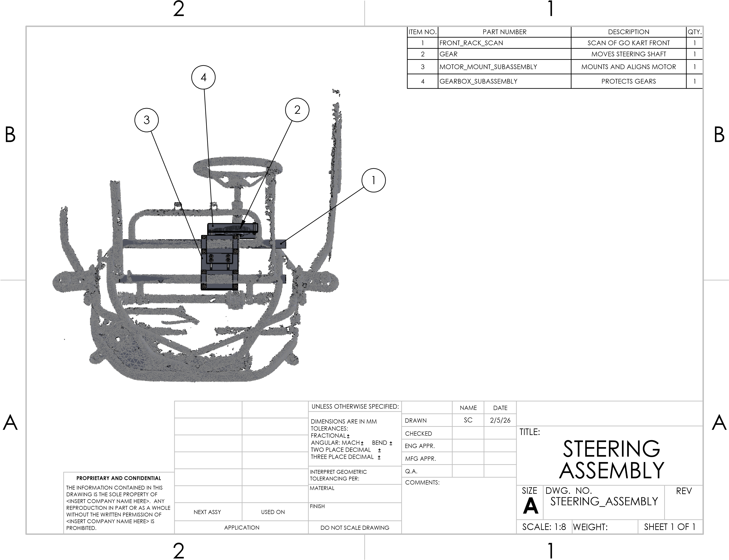
Steering
Updates:
Motor Mount Redesign
Gear box Manufacturing
Finalized & Attached Gears
Removed Electrical Box
Calculations:
Baseplate thickness
U Clamp thickness
Required Minimum Gear Ratio
Gear System Stress Analysis
Technical Drawing of Steering Assembly
SC 5

Slide 6
Steering
Calculation Design Results
Baseplate thickness ~4mm minimum for aluminum
U Clamp thickness ~ 0.841mm for steel
Required Minimum Gear Ratio ~ 1:2
Gear System Stress Analysis
  Allowable Bending Stress ~ 1.644 N/mm^2 (pinion) & 12.53 N/mm^2 (gear)
  Calculated Bending Stress ~ 1.644 N/mm^2 (pinion) & 12.53 N/mm^2 (gear)
  Allowable Contact Stress ~ 14.743 N/mm^2 (pinion) & 13.458 N/mm^2 (gear)
  Calculated Contact Stress ~ 13.458 N/mm^2 (pinion) & 14.743 N/mm^2 (gear)
All calculations can be found in the appendix
SC 6

Slide 7
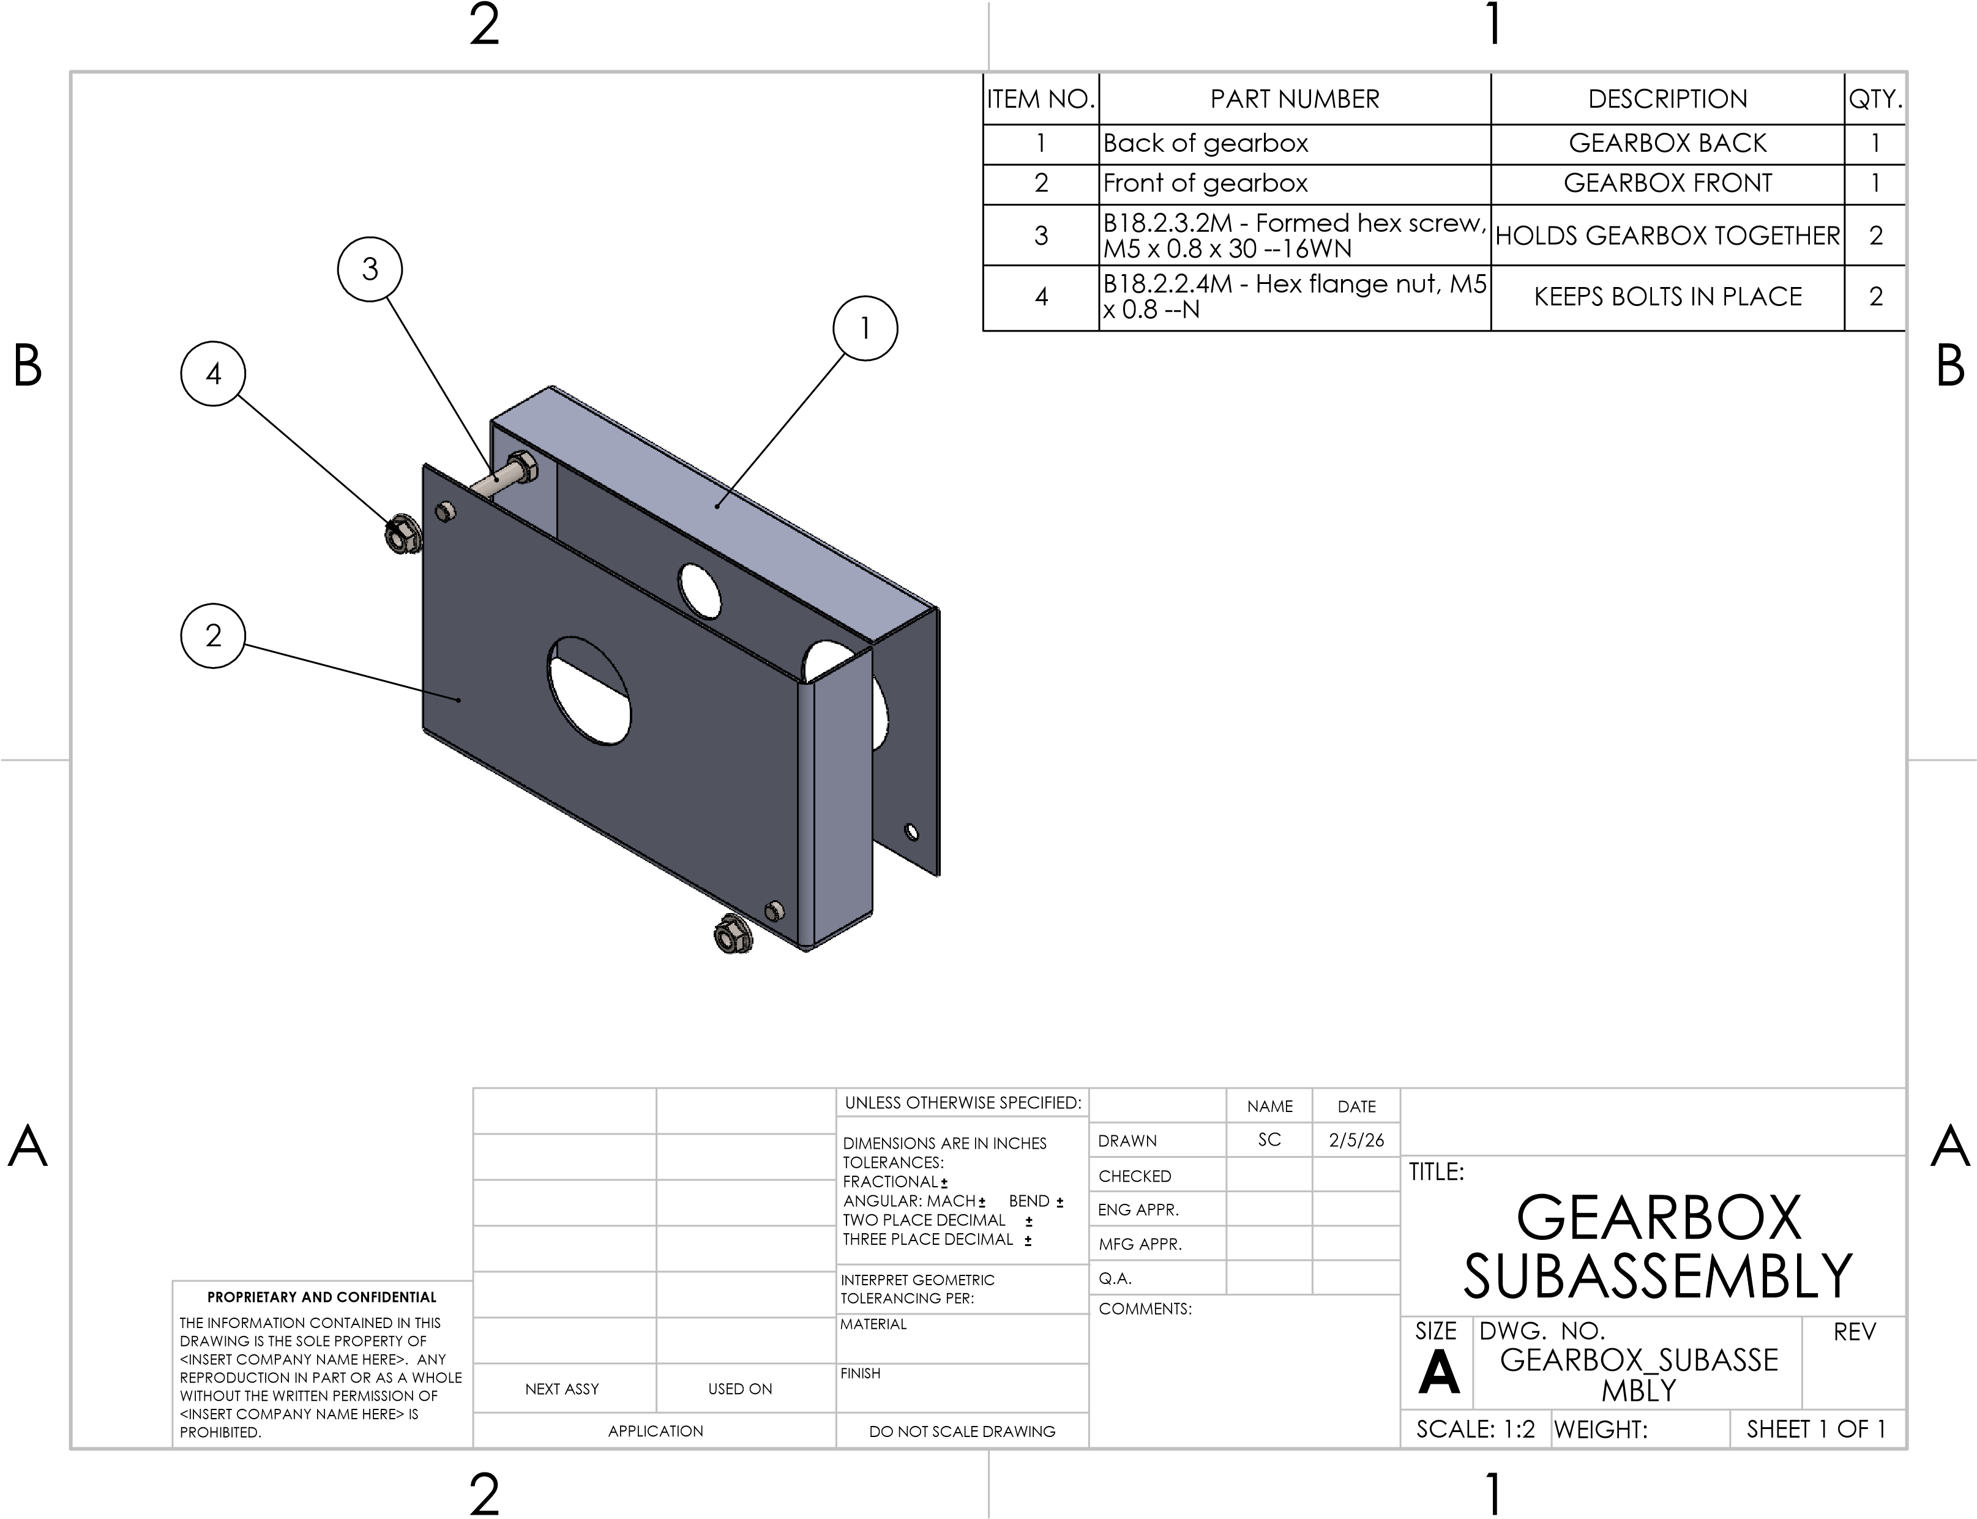
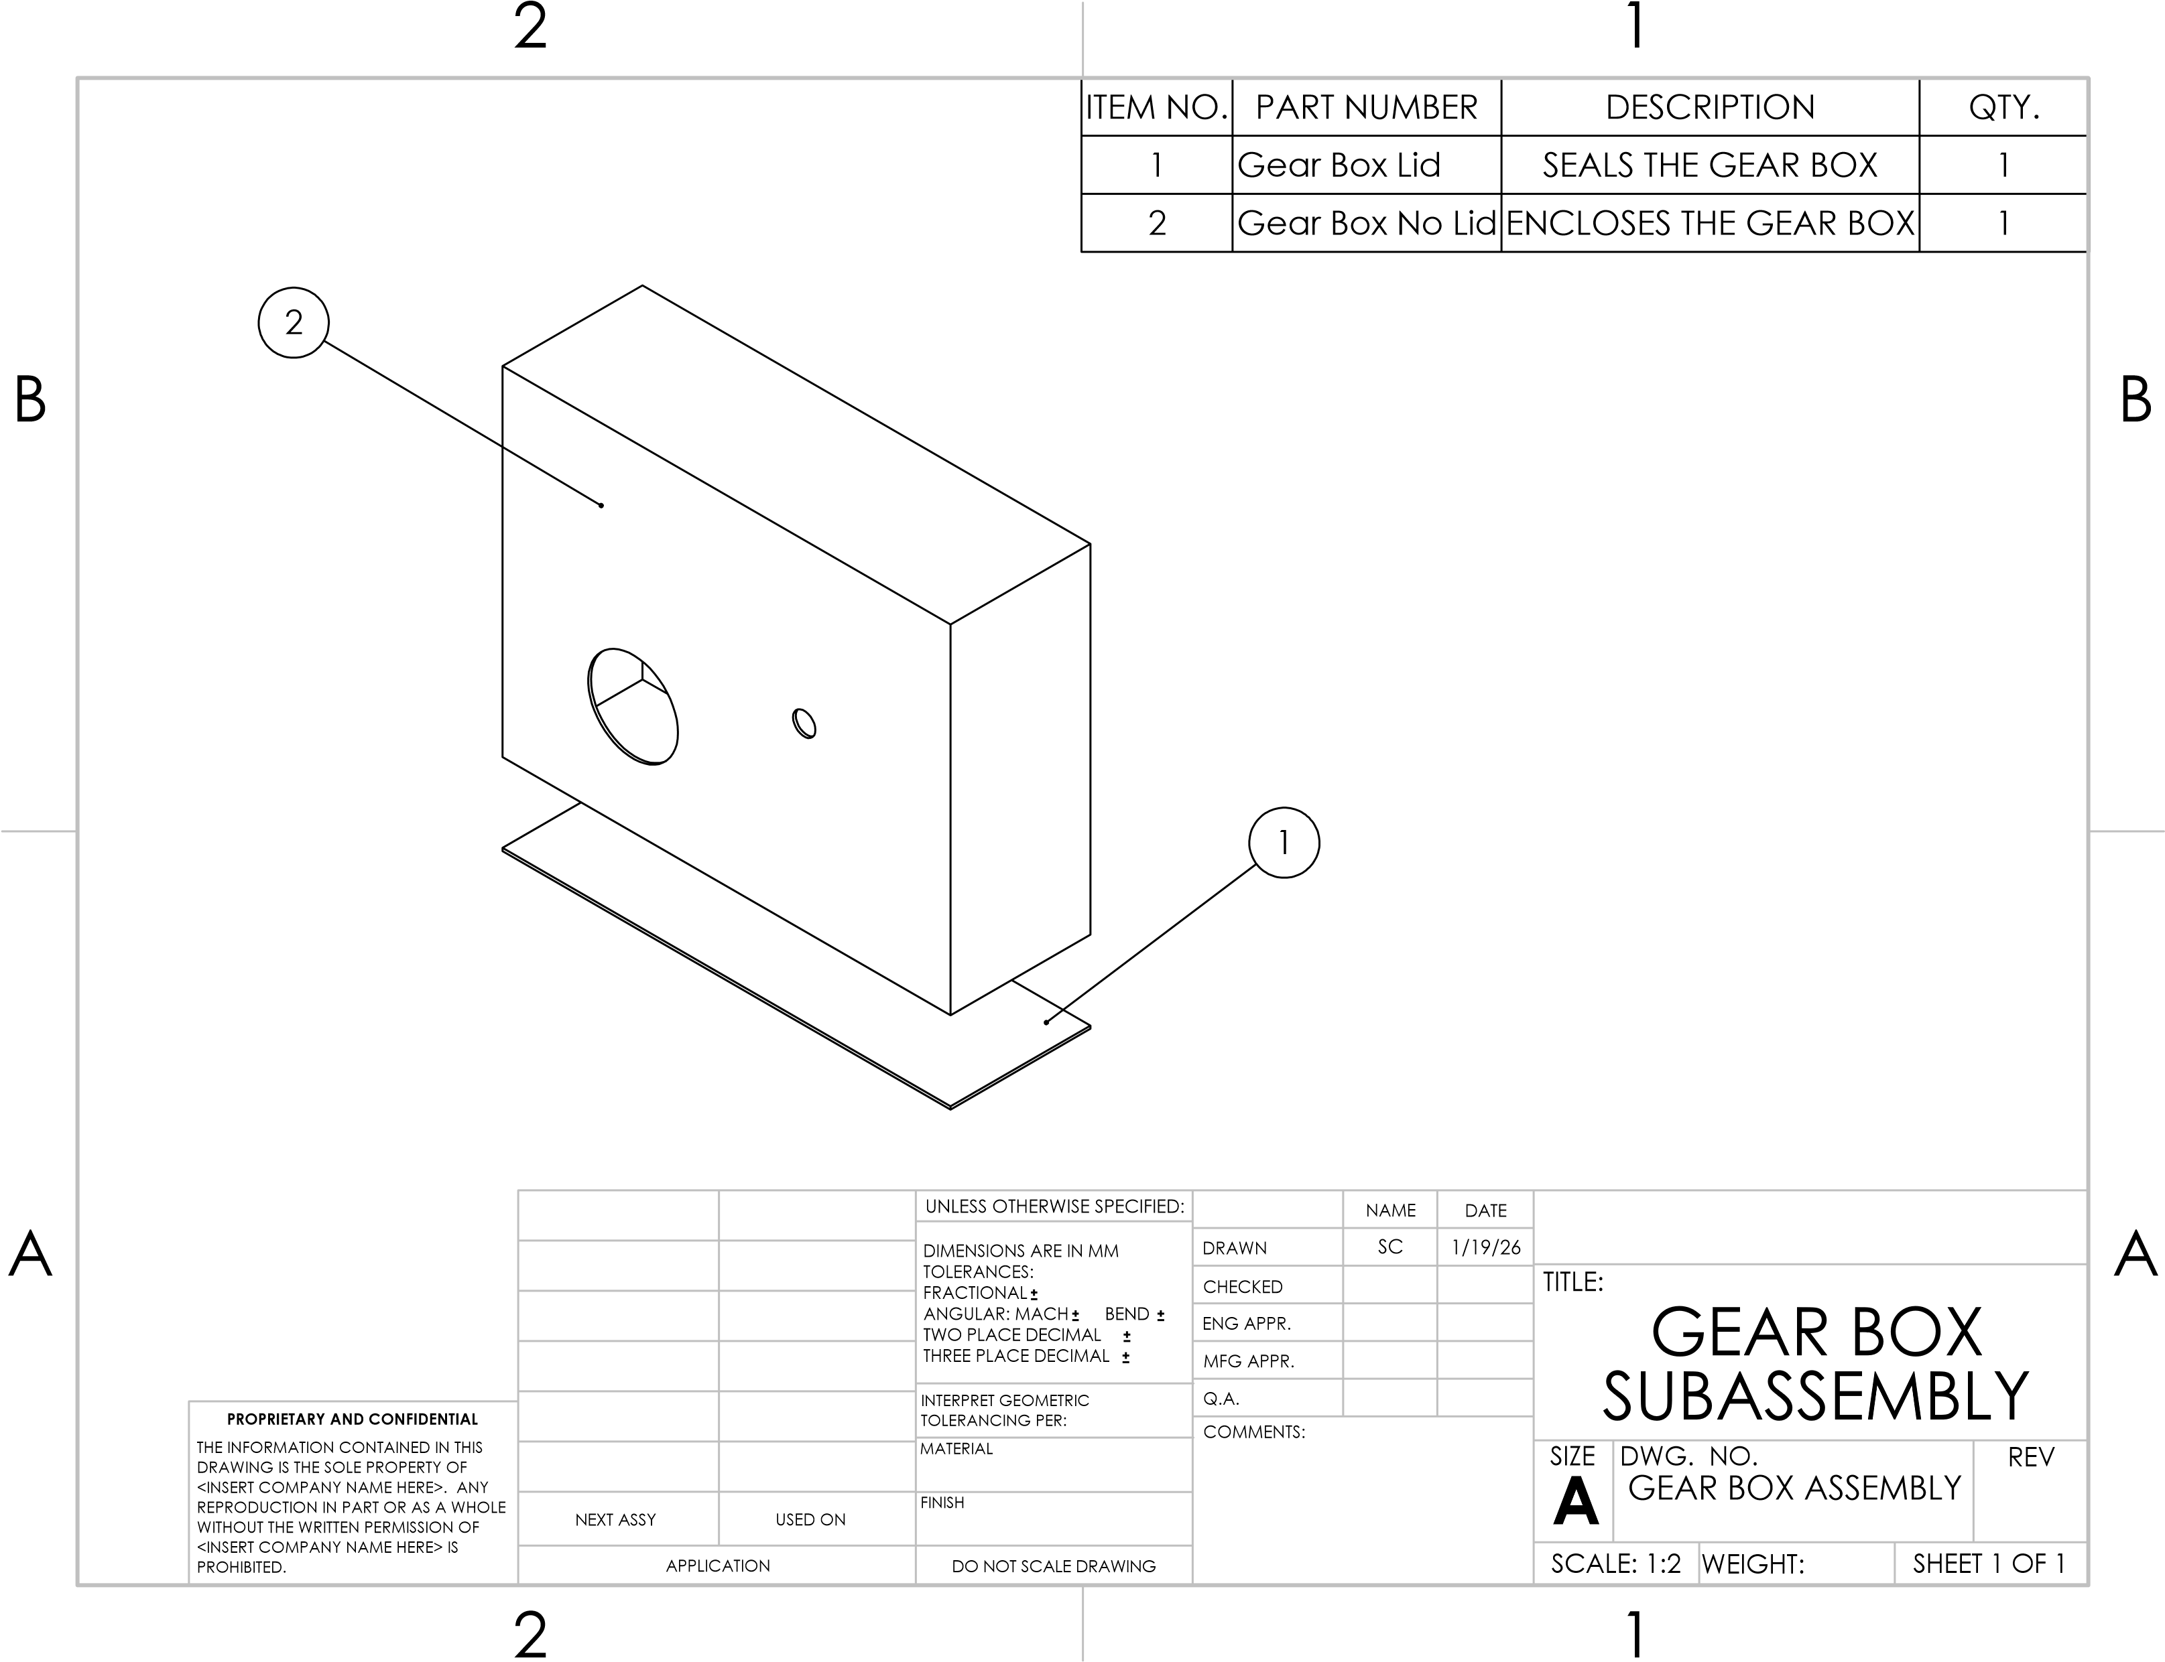
Steering
Gearbox Progression
Previous Gear Box Design
Current Gear Box Design
SC 7

Slide 8
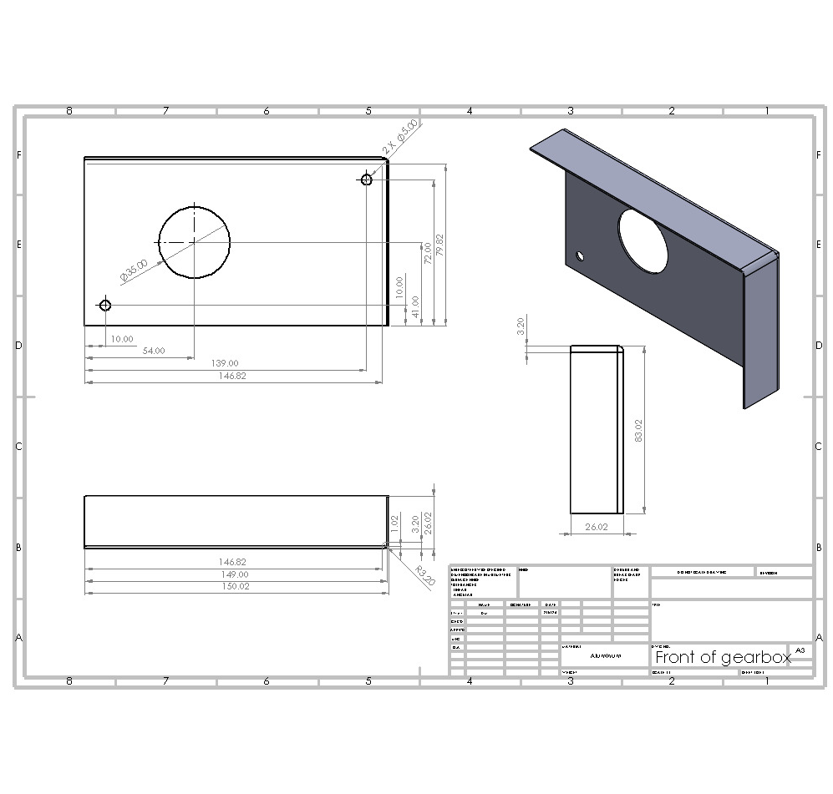
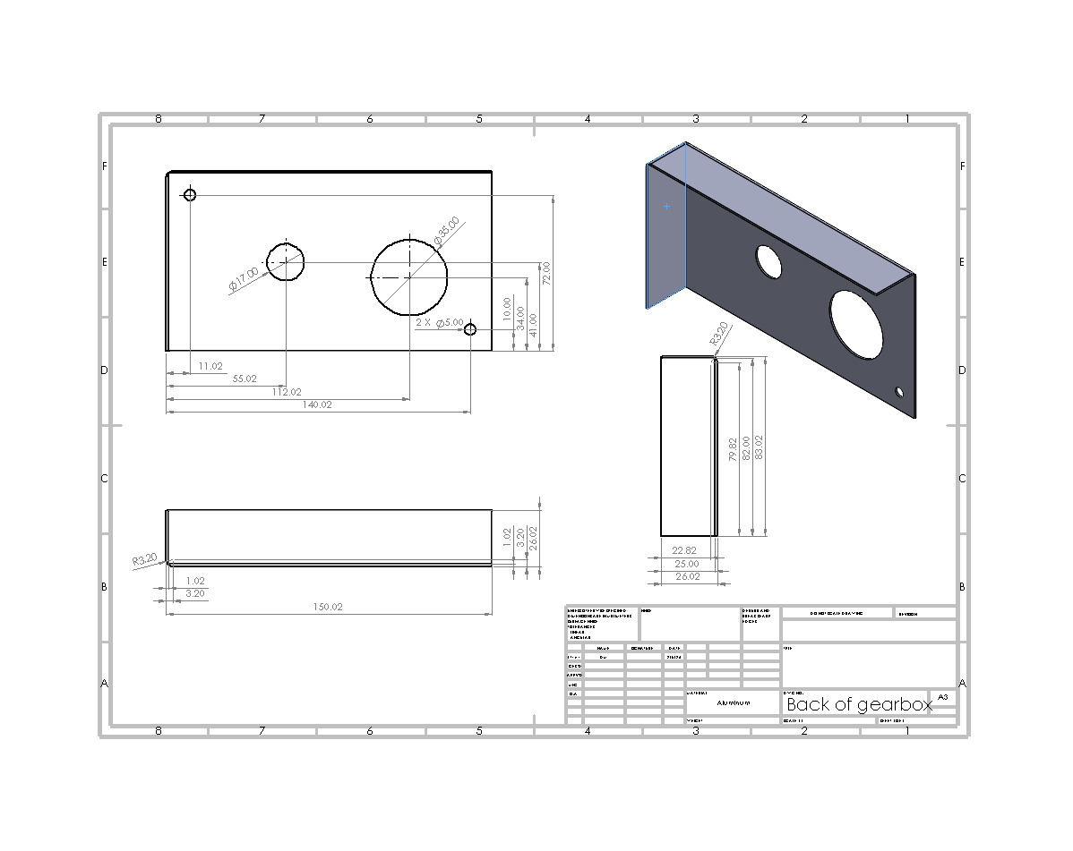
Steering
New Gearbox Drawing
Current Gearbox Front
Current Gearbox Back

Slide 9
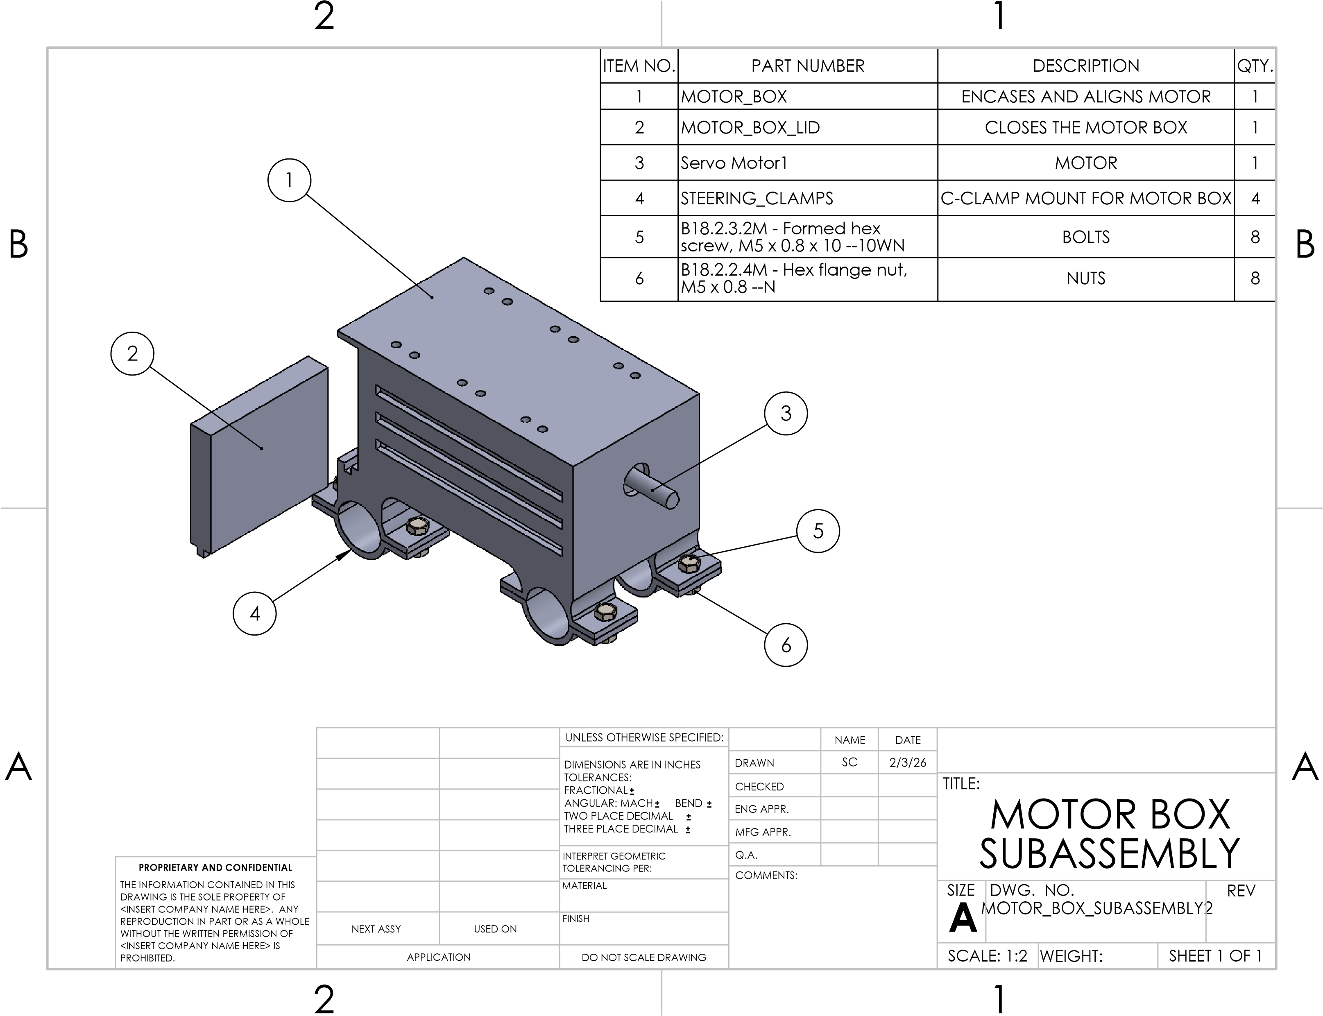
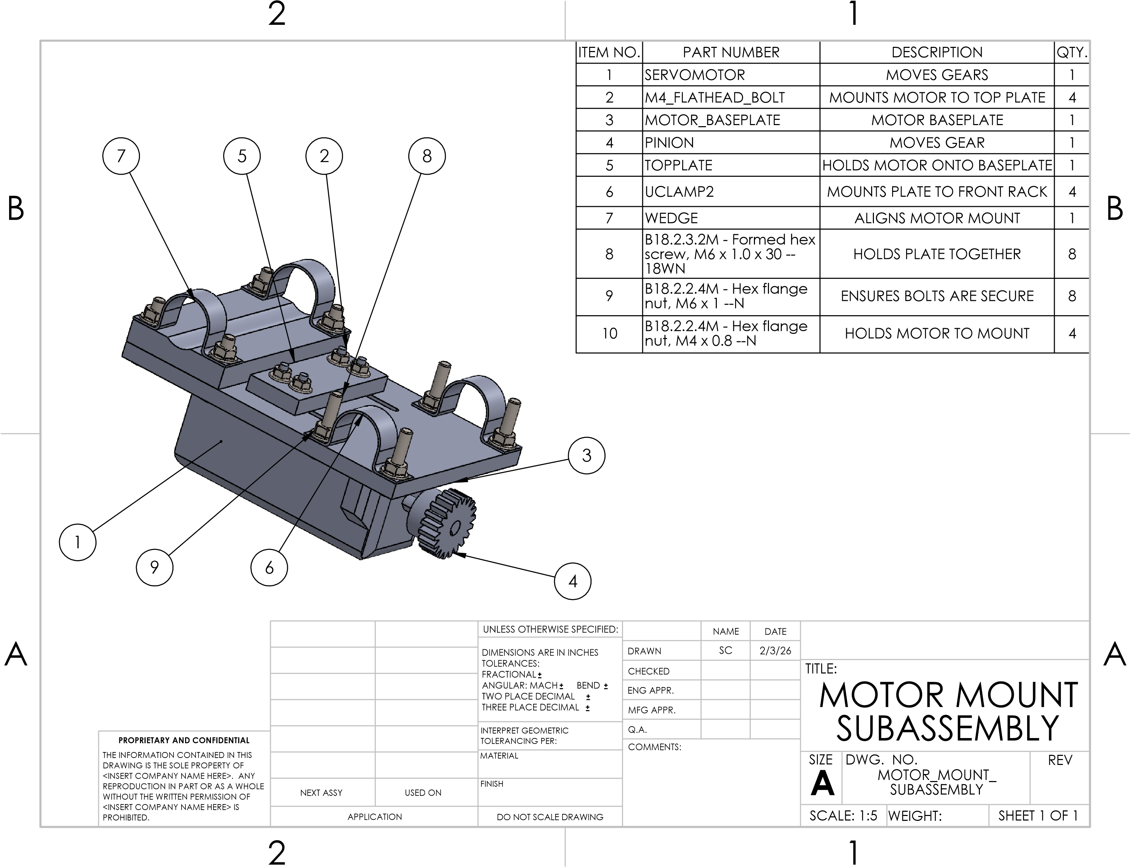
Steering
Motor Mount Progression
Previous Motor Mount Design
Current Motor Mount Design
SC 8

Slide 10
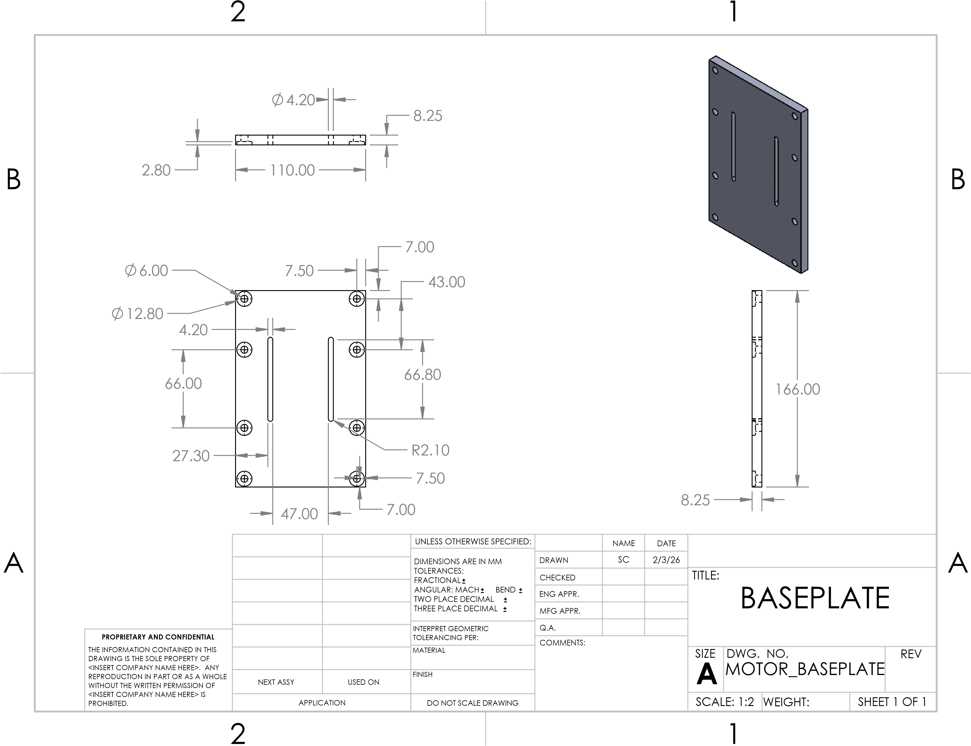
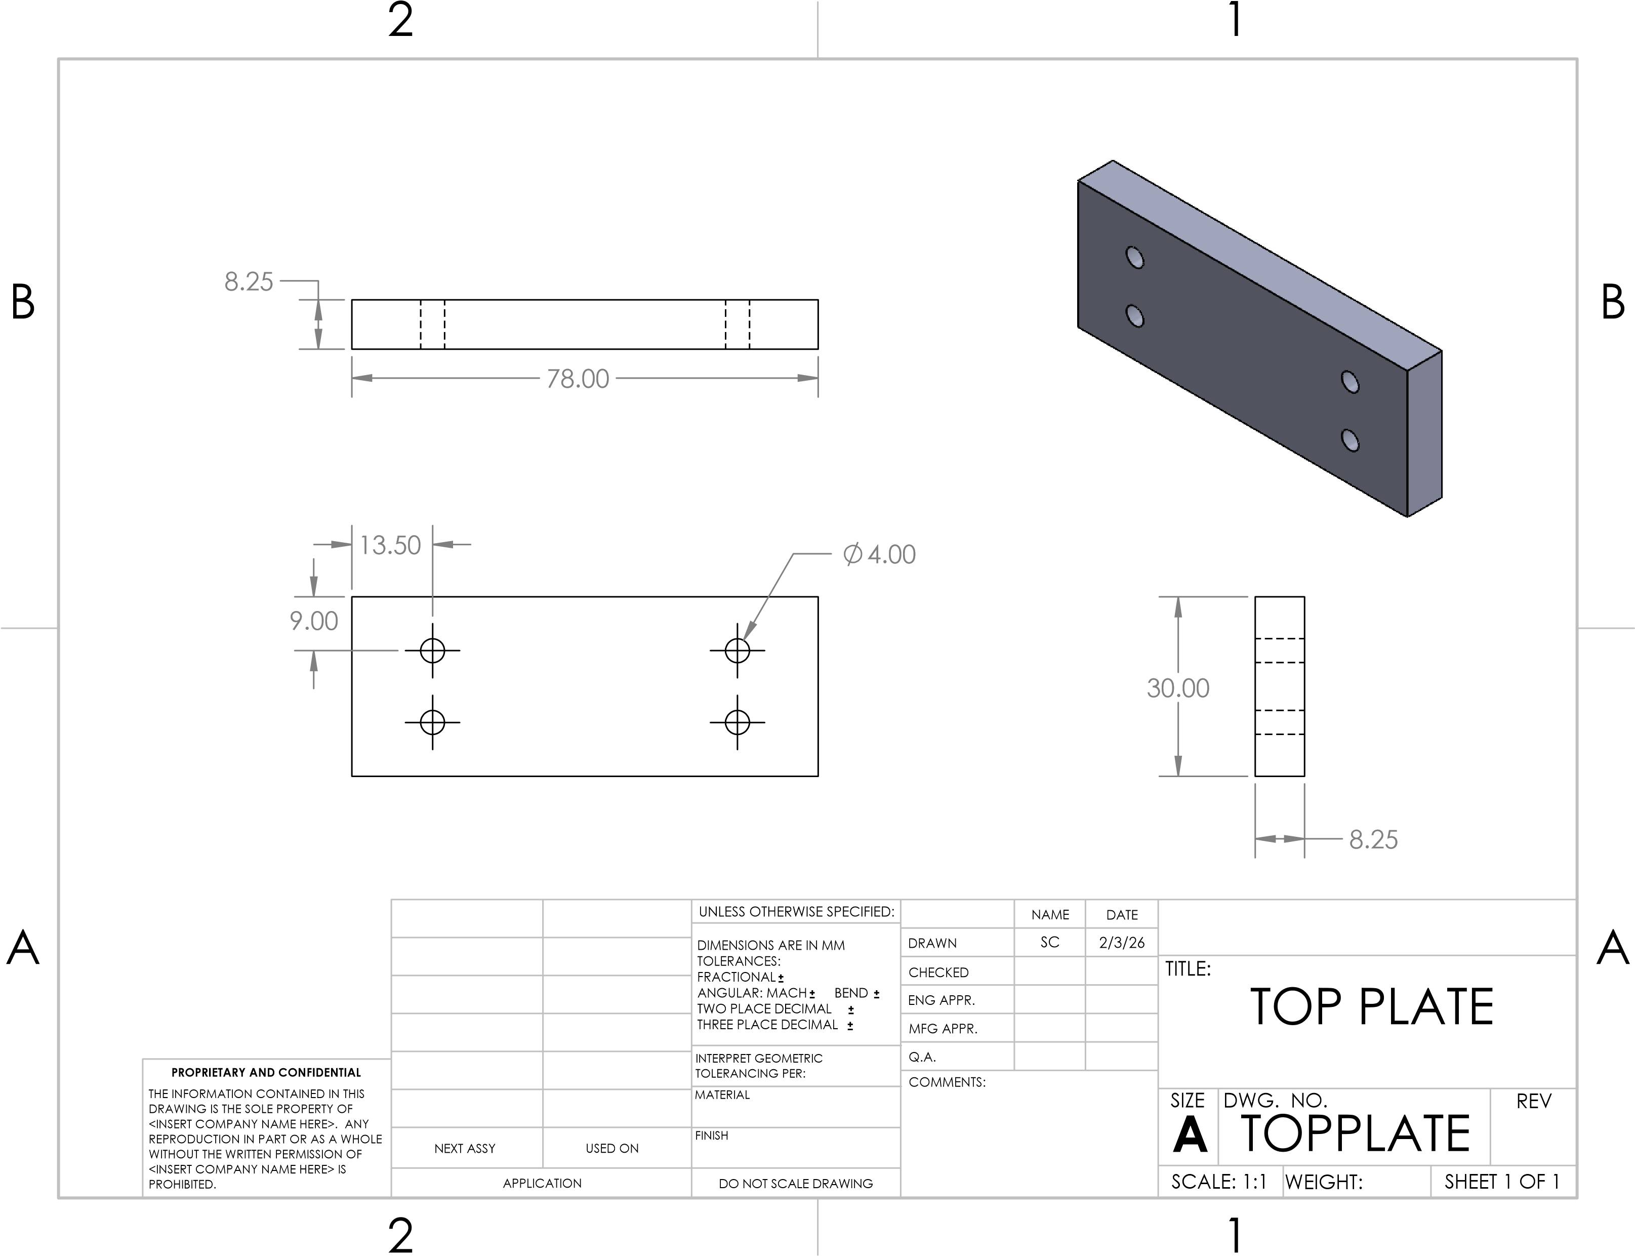
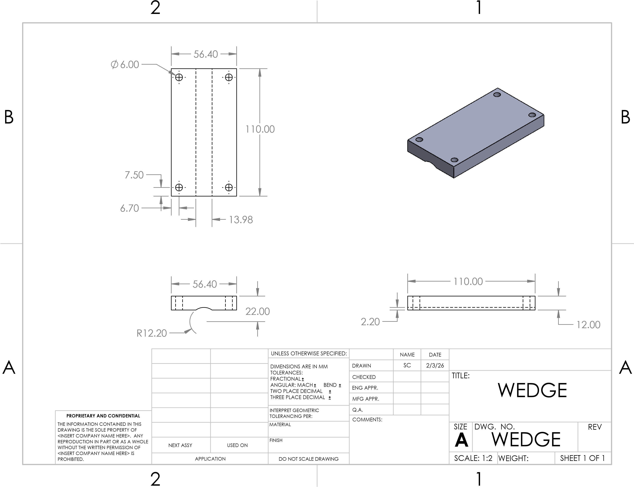
Steering
Baseplate Drawing
Top Plate Drawing
Wedge Drawing

Slide 11
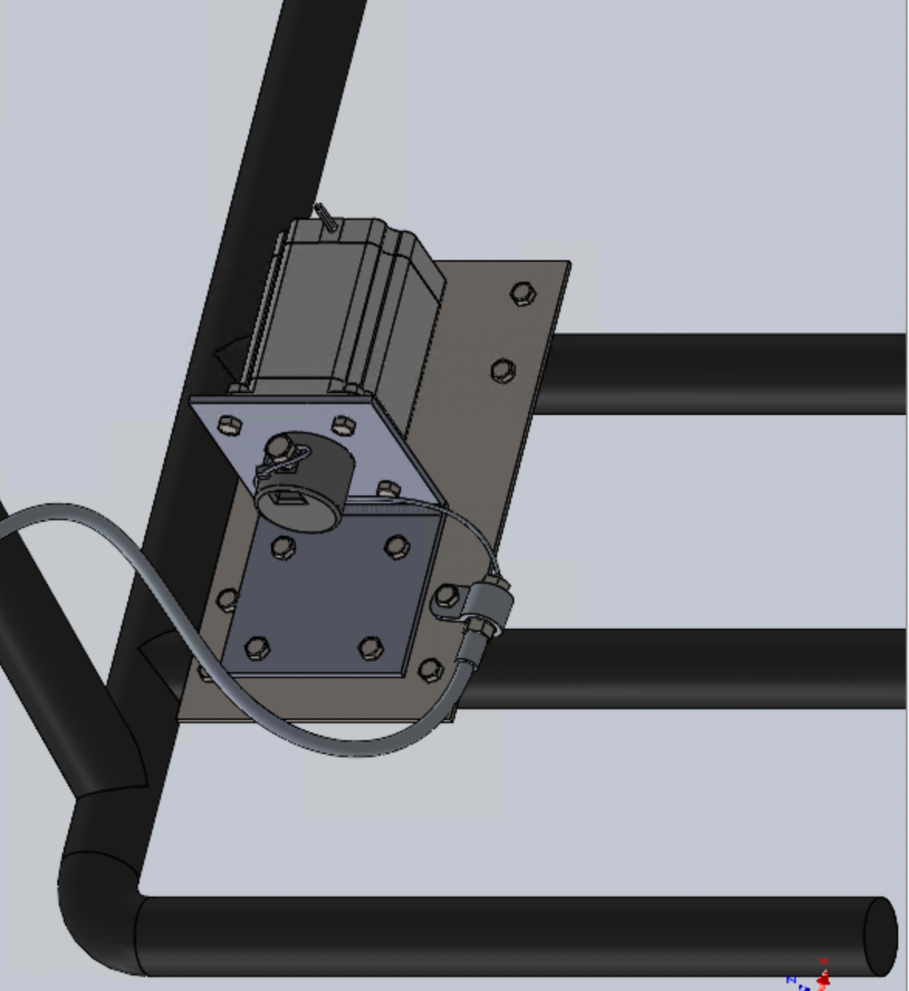
Throttle
Design Overview
Changes:
Cable
  Original Component: Cable Wire
  New Component: Bowden Cable
Assembly Location
  Original: Top Chassis
  New: Bottom Chassis
Spool
  Original: Glued Cable
  New: Cable and Shaft Held by Set Screw
Stepper Mount
  Original: (2) 8in L-Brackets
  New: (1) Welded 3in. x 3in. L-Bracket
Mechanical Driving System
  Original: Pedal with Potentiometer
  New: Hand Accelerator
Throttle Stepper Assembly
NP 9

Slide 12
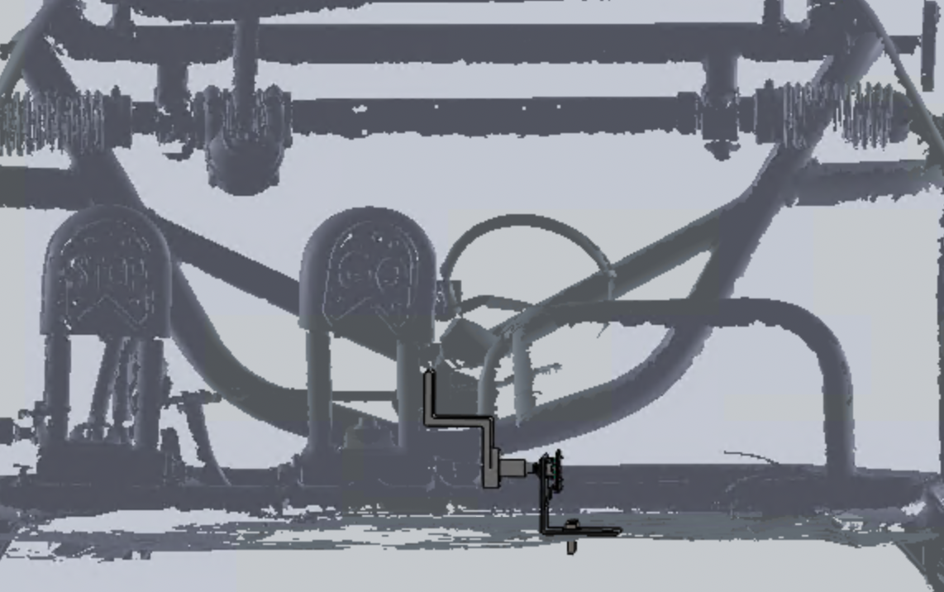
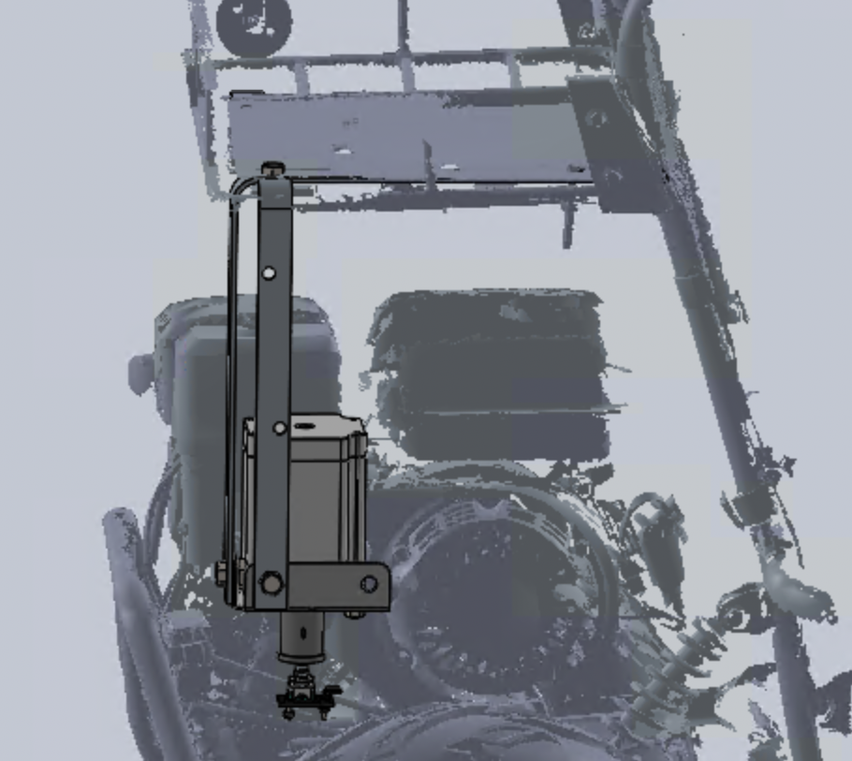
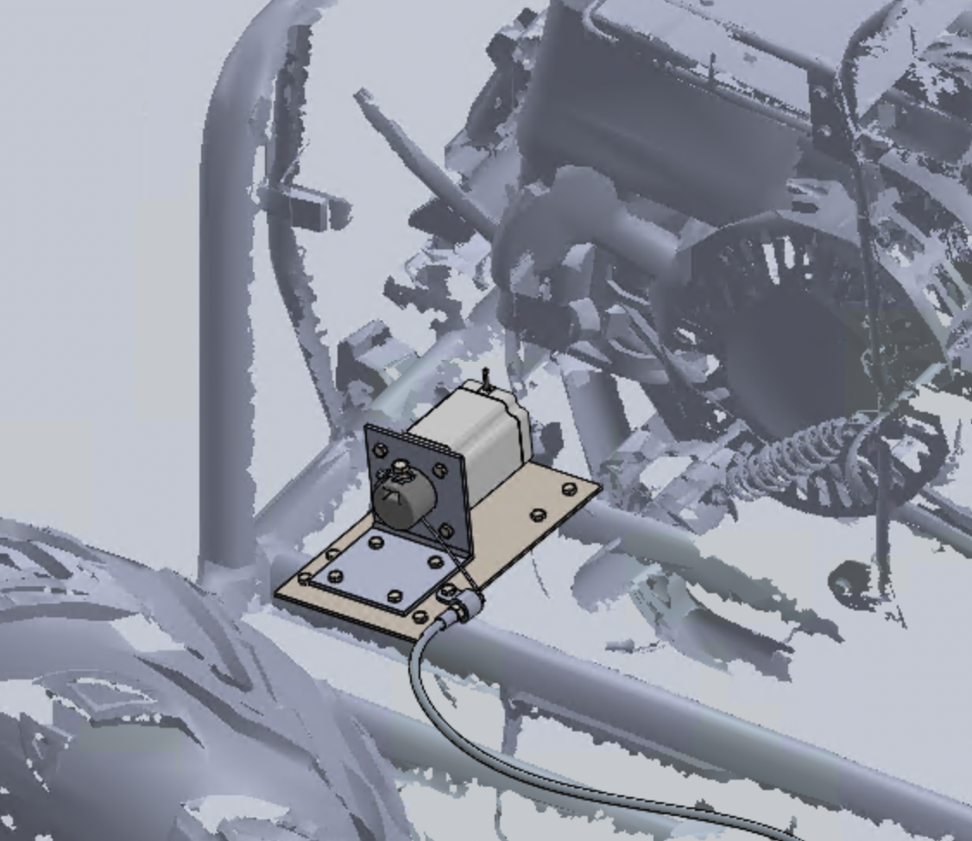
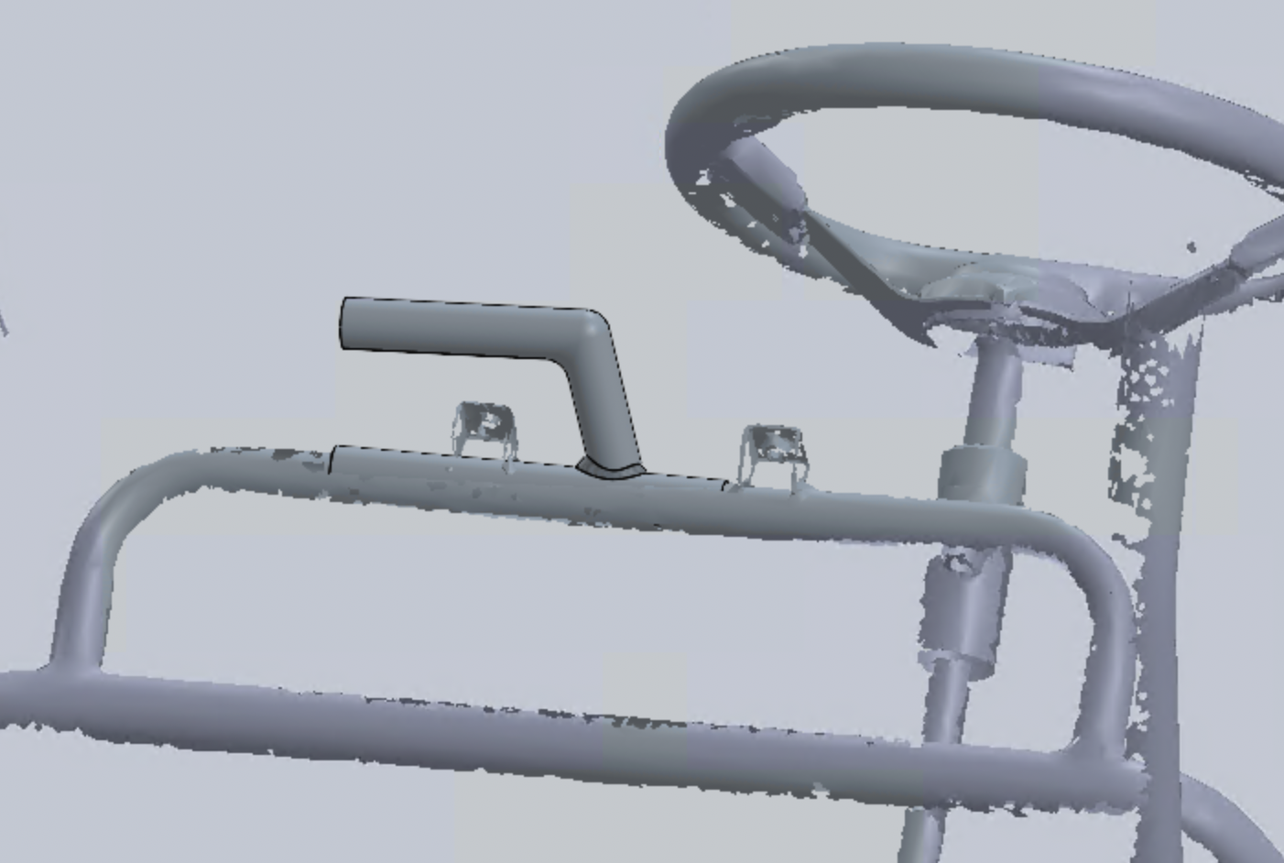
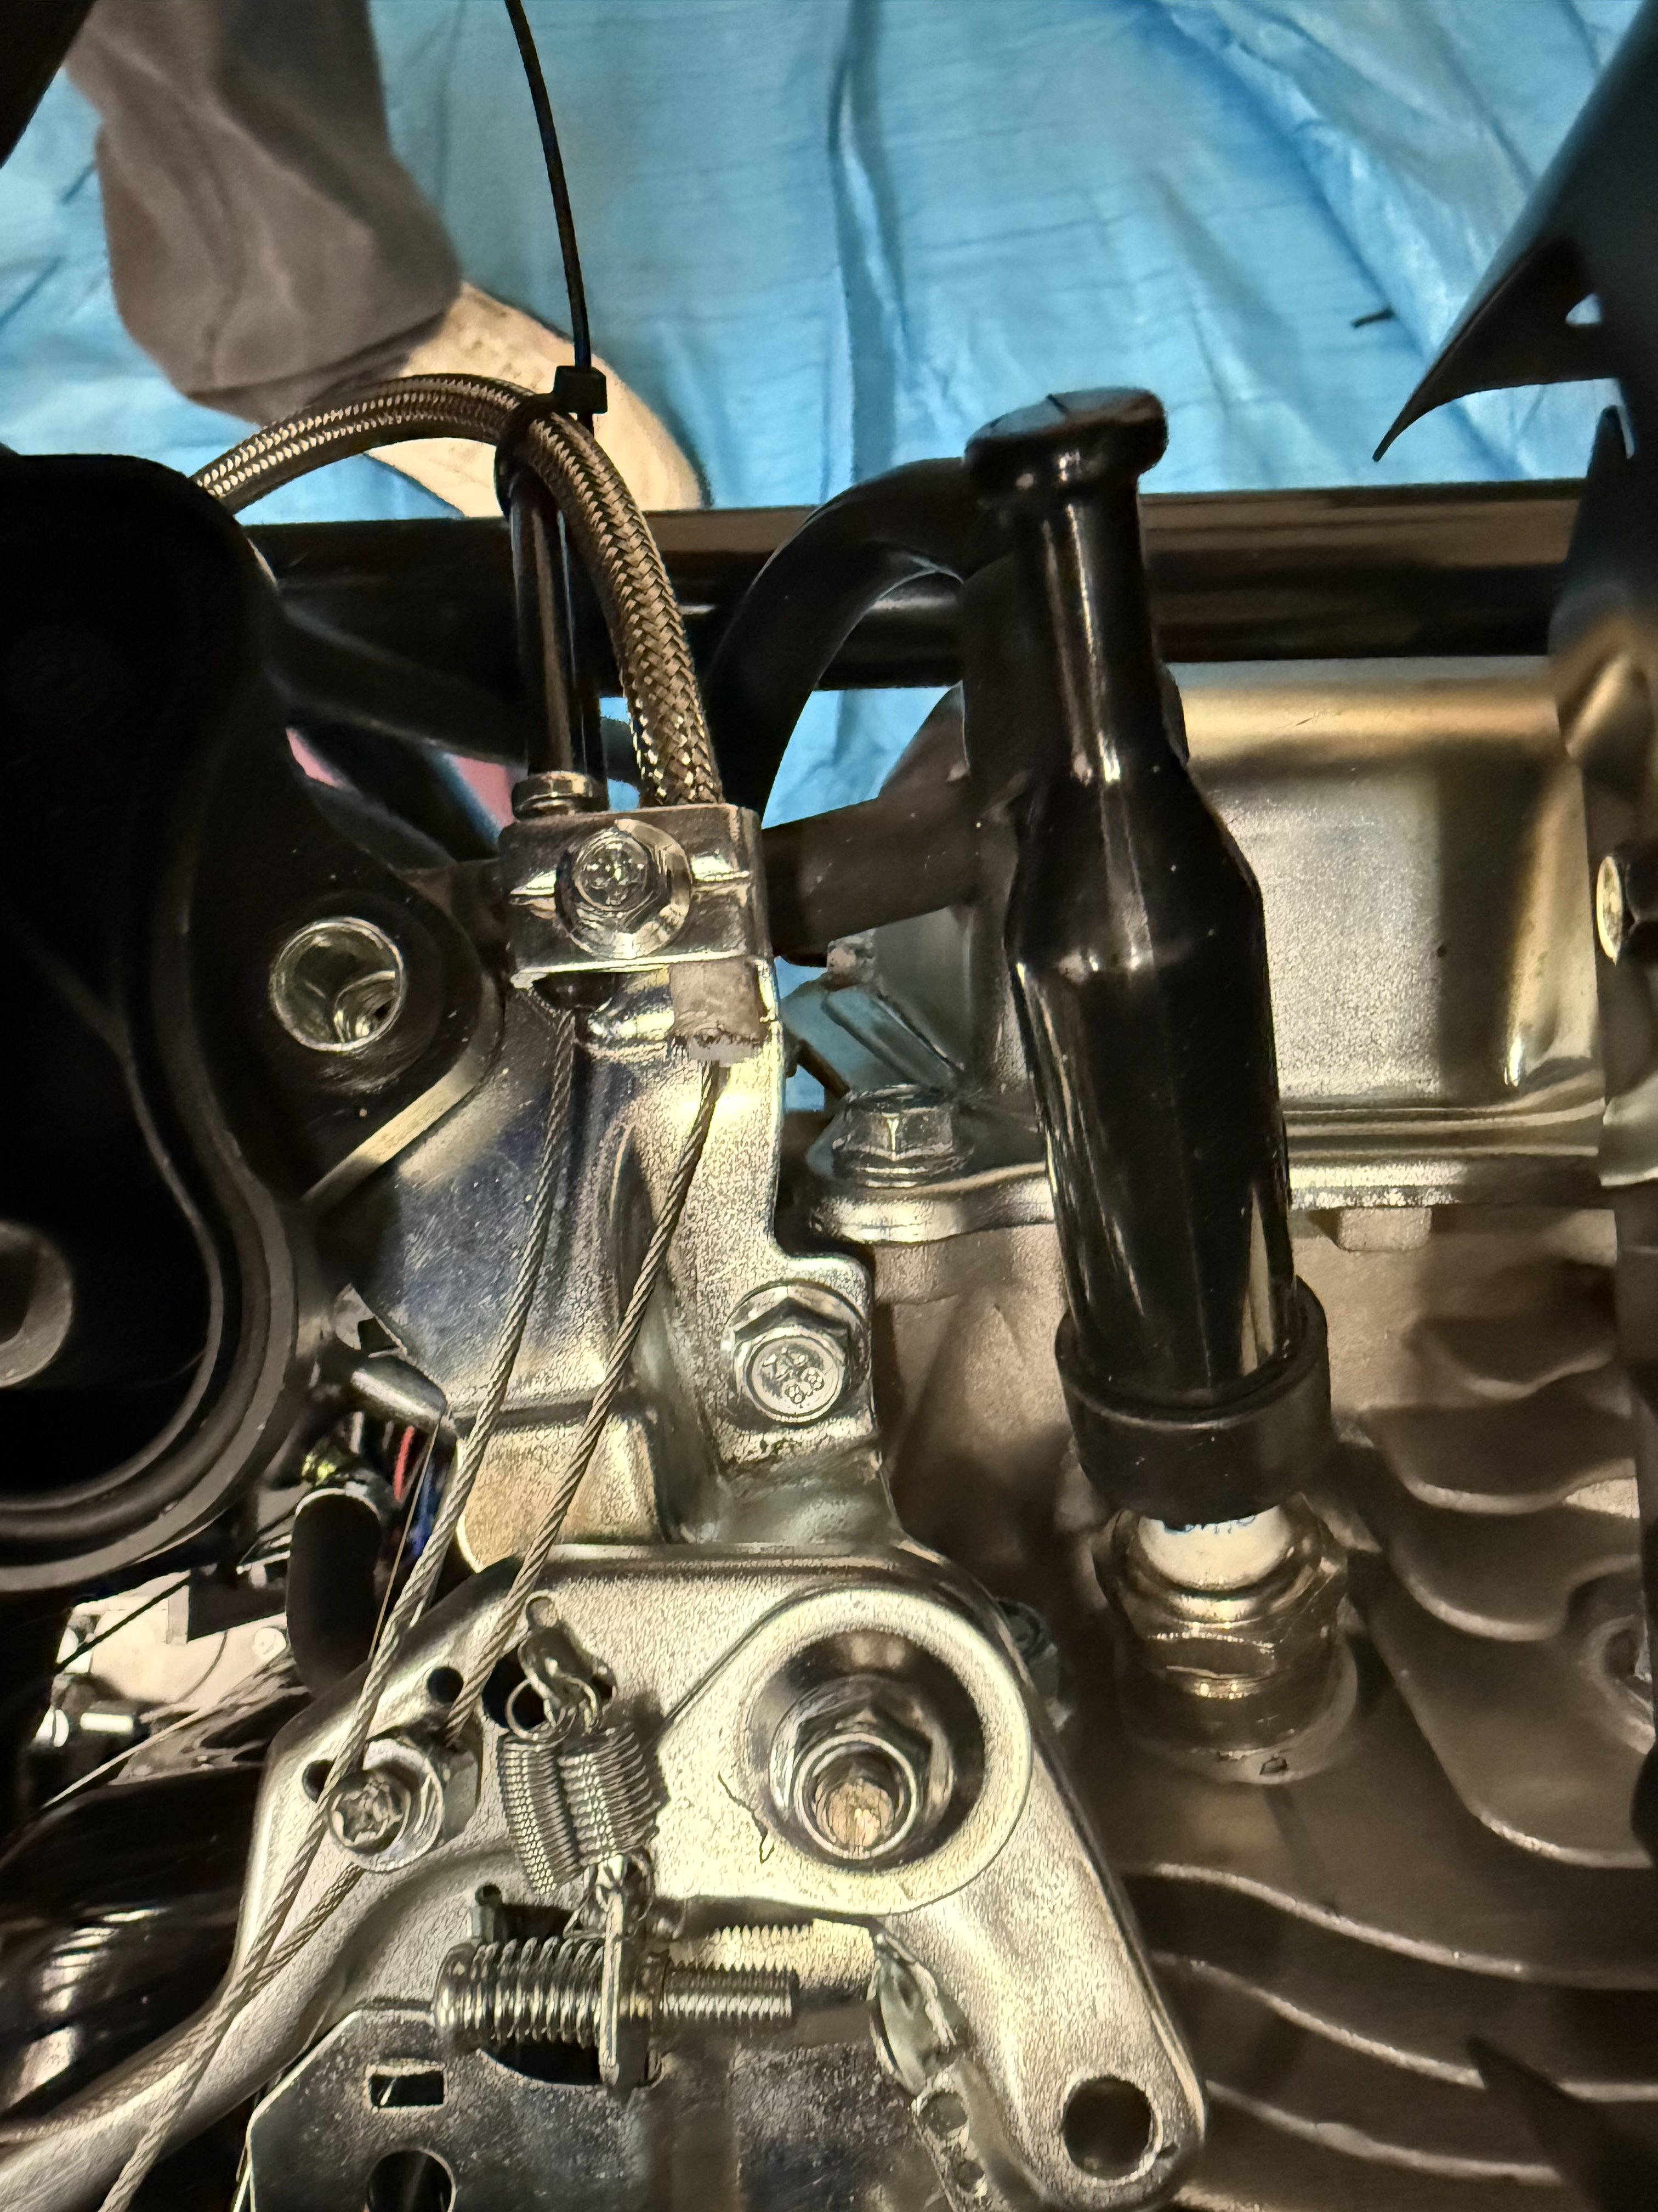
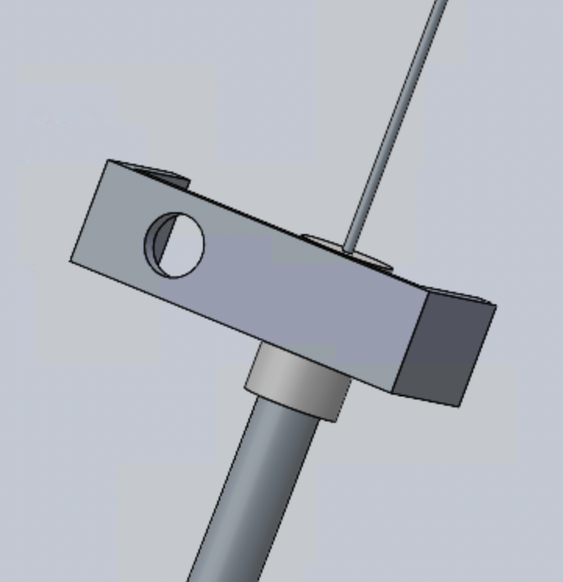
Throttle
Design Evolution
Original Pedal Control Design
Original Stepper Design
Updated Stepper Design
Updated Pedal Control Design
Original Bowden Support
Updated Bowden Support
NP 10

Slide 13
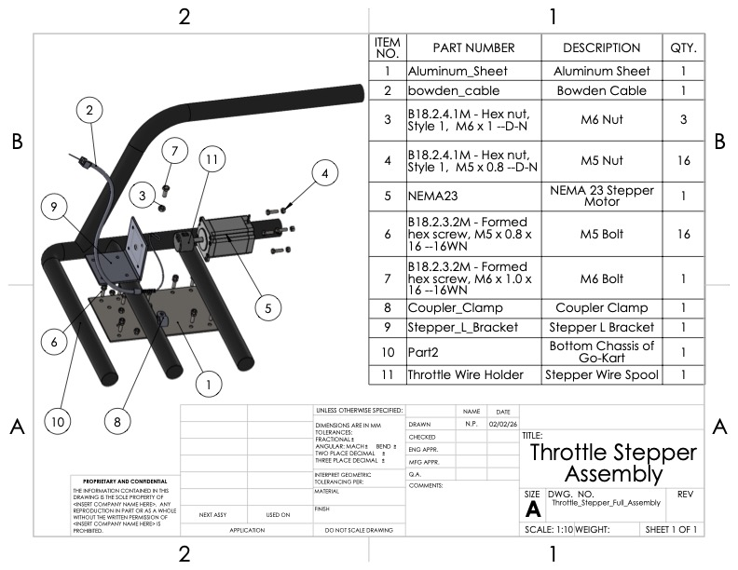
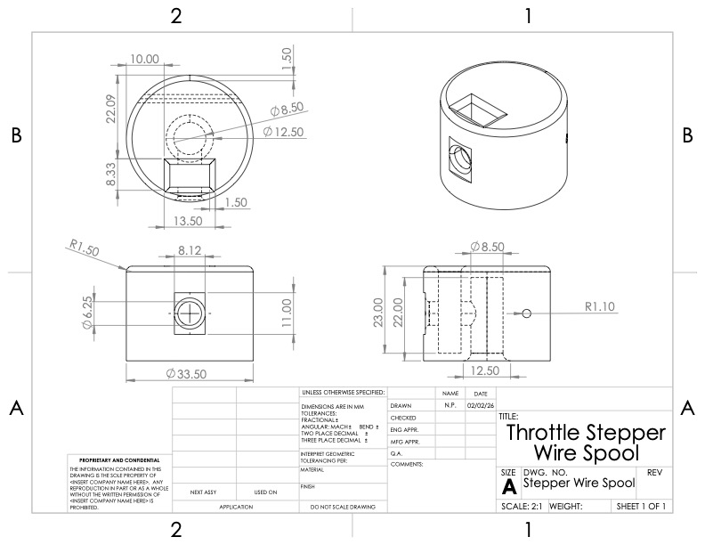
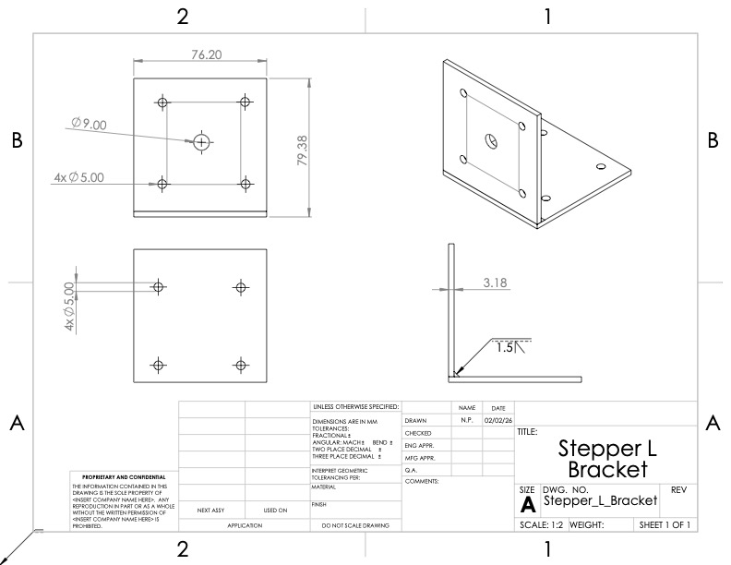
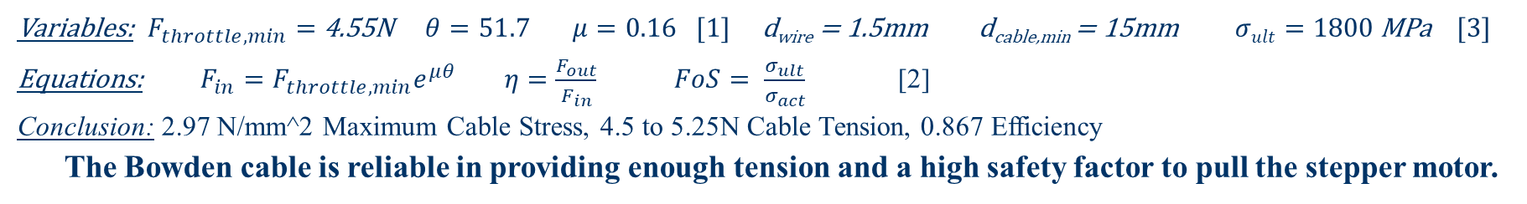
Throttle
Schematics and Calculations
New Question: Does the chosen Bowden cable offer enough tension and efficiency to safely withstand the stepper motor?
Variables: $F_{throttle,min}=$ 4.55N $θ=51.7$ $μ=0.16$ [1] d_{wire} = 1.5mm d_{cable,min} = 15mm $σult=1800$ MPa [3]
Equations: $F_{in}=F_{throttle,min}e^{μθ}$ $η=\frac{F_{out}}{F_{in}}$ $FoS= \frac{σ_{ult}}{σ_{act}}$ [2]
Conclusion: 2.97 N/mm^2 Maximum Cable Stress, 4.5 to 5.25N Cable Tension, 0.867 Efficiency
The Bowden cable is reliable in providing enough tension and a high safety factor to pull the stepper motor.
Throttle Stepper Assembly
Throttle Stepper Wire Spool
Throttle Stepper L-Bracket
NP 11

Slide 14
Purchasing & Manufacturing Plan

Slide 15
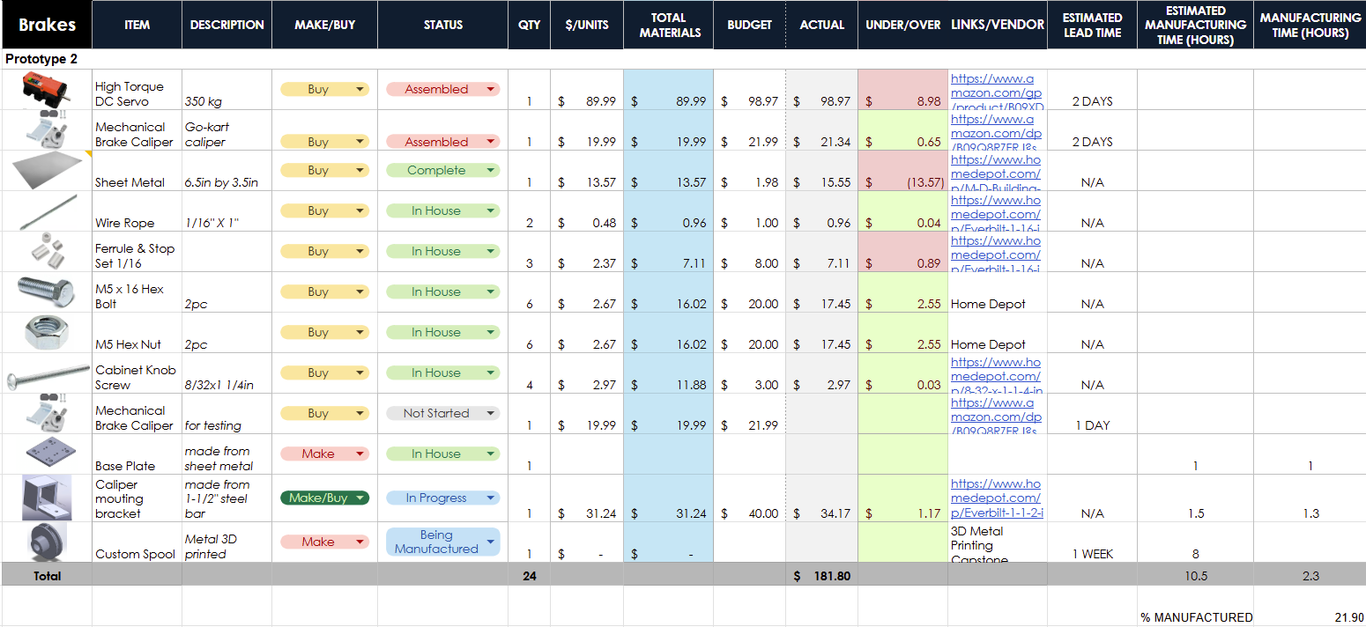
Brakes
Completed ​
Caliper mounting bracket prototype (cut, welded, milled from A36 flat bar)​
Motor Mounting Bracket prototype ​
FEA on resized spool channel
In Progress​
3D metal printing spooling components.​
Scheduled​
Motor mounting & direct caliper arm actuation (design phase, fabrication pending till February 4th)​
Base plate & bracket re-manufacturing- Feb 5th (for precision & fit)​
Spool 3D metal printing & production, targeted for, Feb 9-12th​
% Purchased | 90 %
% On-Hand | 90 %
% Manufactured | 21.90%
JK 13

Slide 16
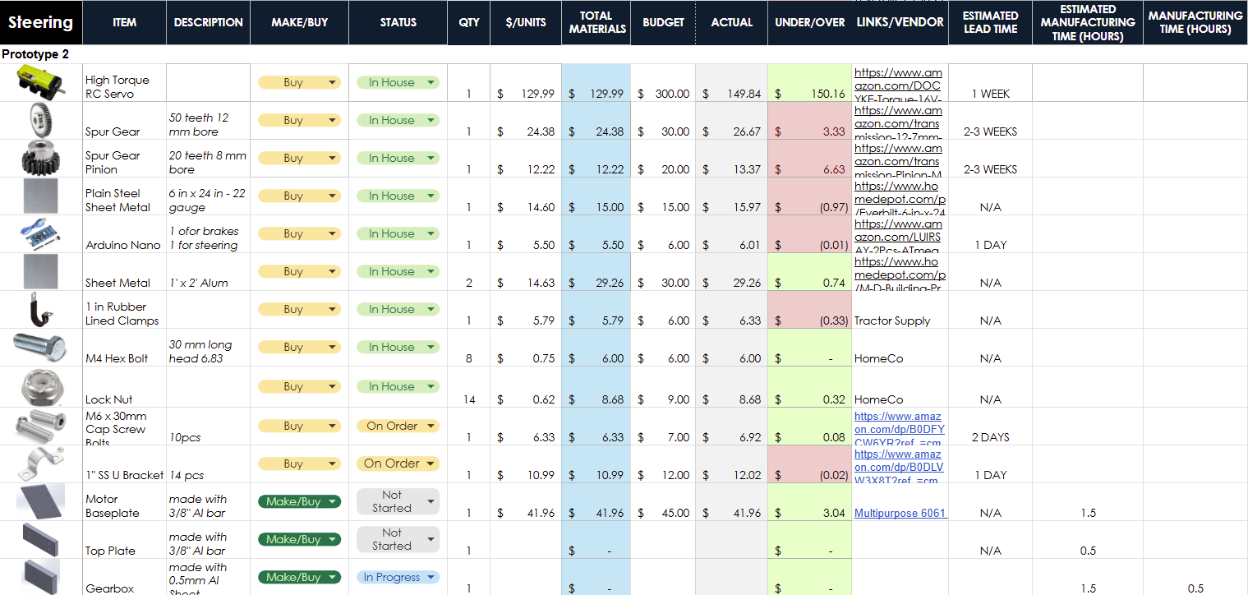
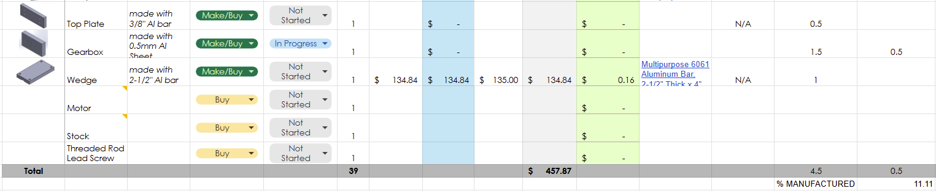
Steering
Completed ​
Gearbox
Motor Mounting prototype ​& design
Gears Finalization
In Progress​
Manufacturing motor mount
Motor Testing (Electrical)
Scheduled​
Assembling motor mount (2/9)
Finalizing fail safe mechanism design (2/13)
Complete all mechanical portions (3/16)
% Purchased | 82%
% On-Hand | 70%
% Manufactured | 11.11%
SC 14

Slide 17
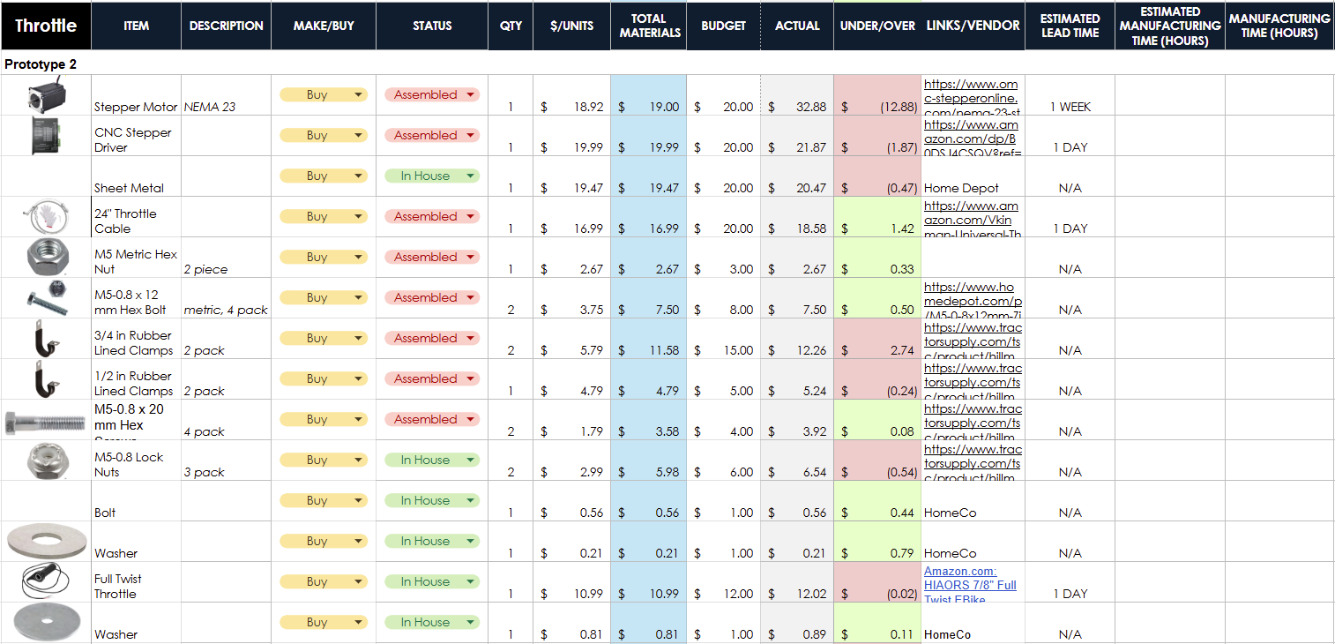
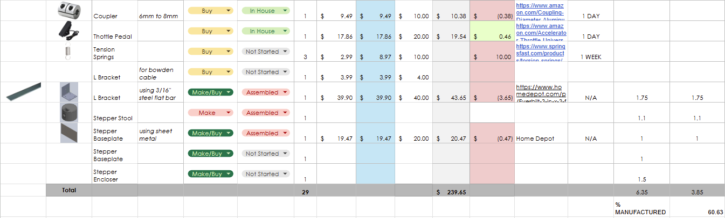
Throttle
Completed
L-bracket for Stepper Motor
Stepper Spool
In Progress
Mounting Acceleration Handle
Bowden Clamping Tip
Scheduled
Upgrade Throttle Lever Spring
Upgrade Base Plate and Clamps
% Purchased | 91%
% On-Hand | 82.6%
% Manufactured | 60.63%
EC 15

Slide 18
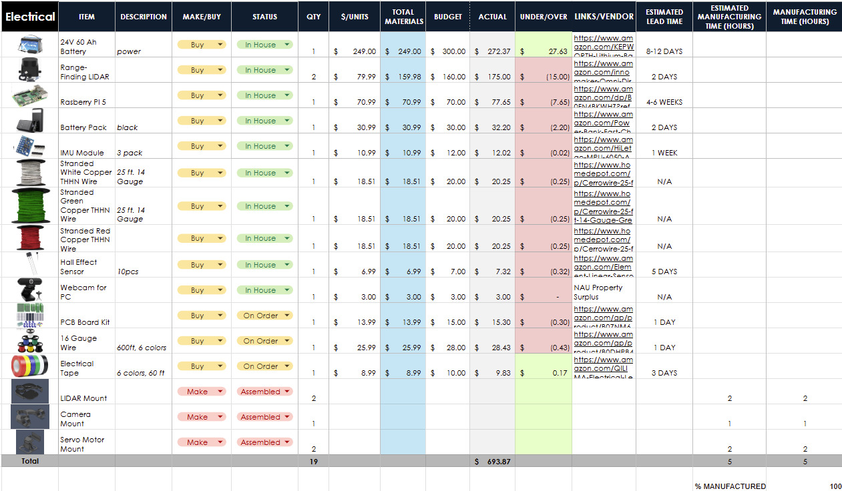
Electrical
Completed
Sensor Mounting
In Progress
Hall Sensor mounting
Wiring
Scheduled
PCB soldering
% Purchased | 100 %
% On-Hand | 81%
% Manufactured | 100%
LQ 16

Slide 19
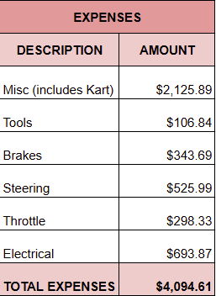
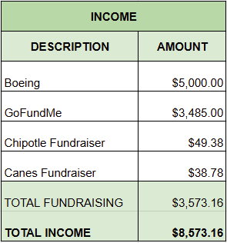

Budget
EC 17

Slide 20
Demonstrations

Slide 21
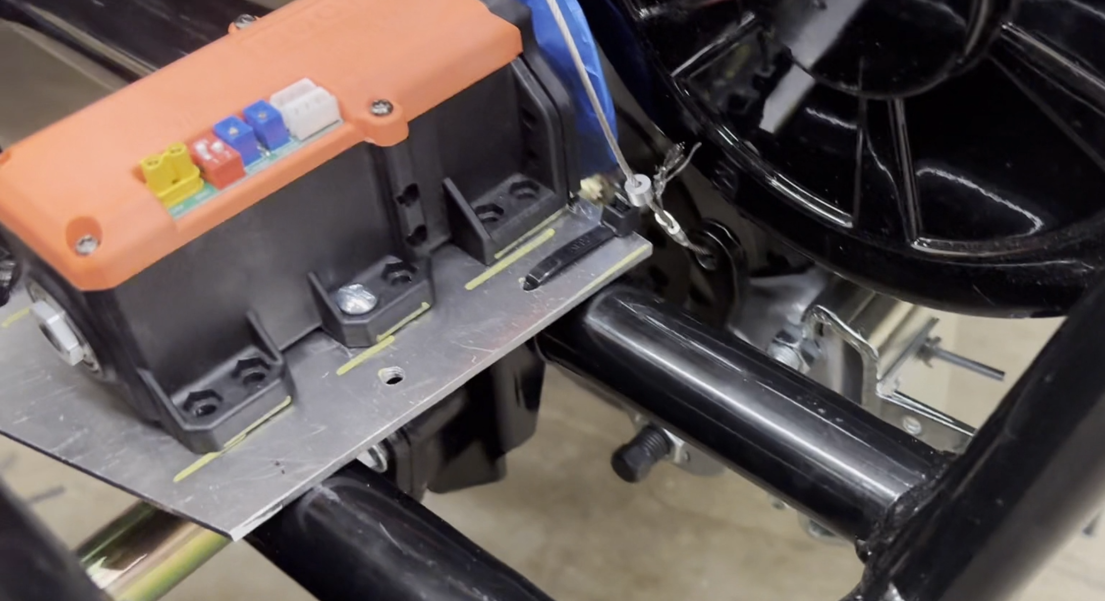
Brakes
ML 19

Slide 22
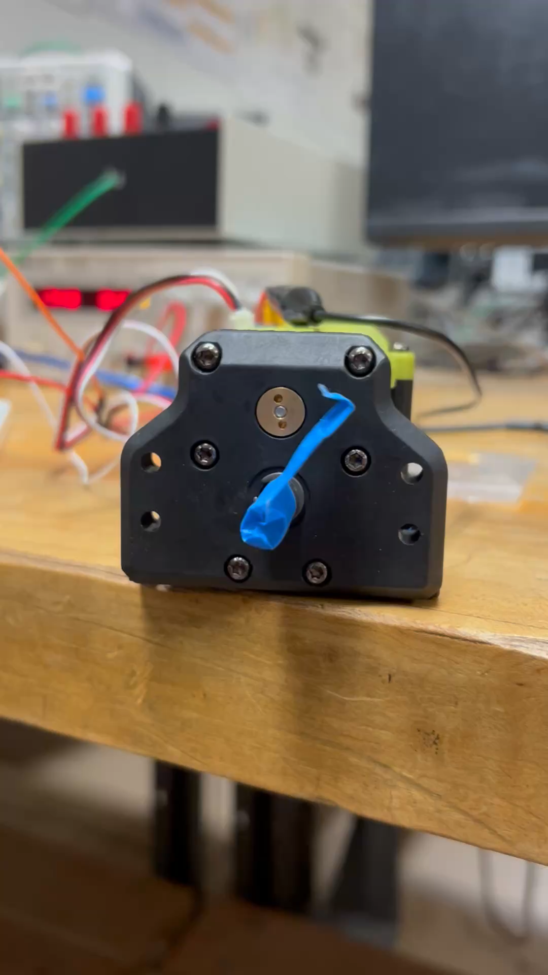
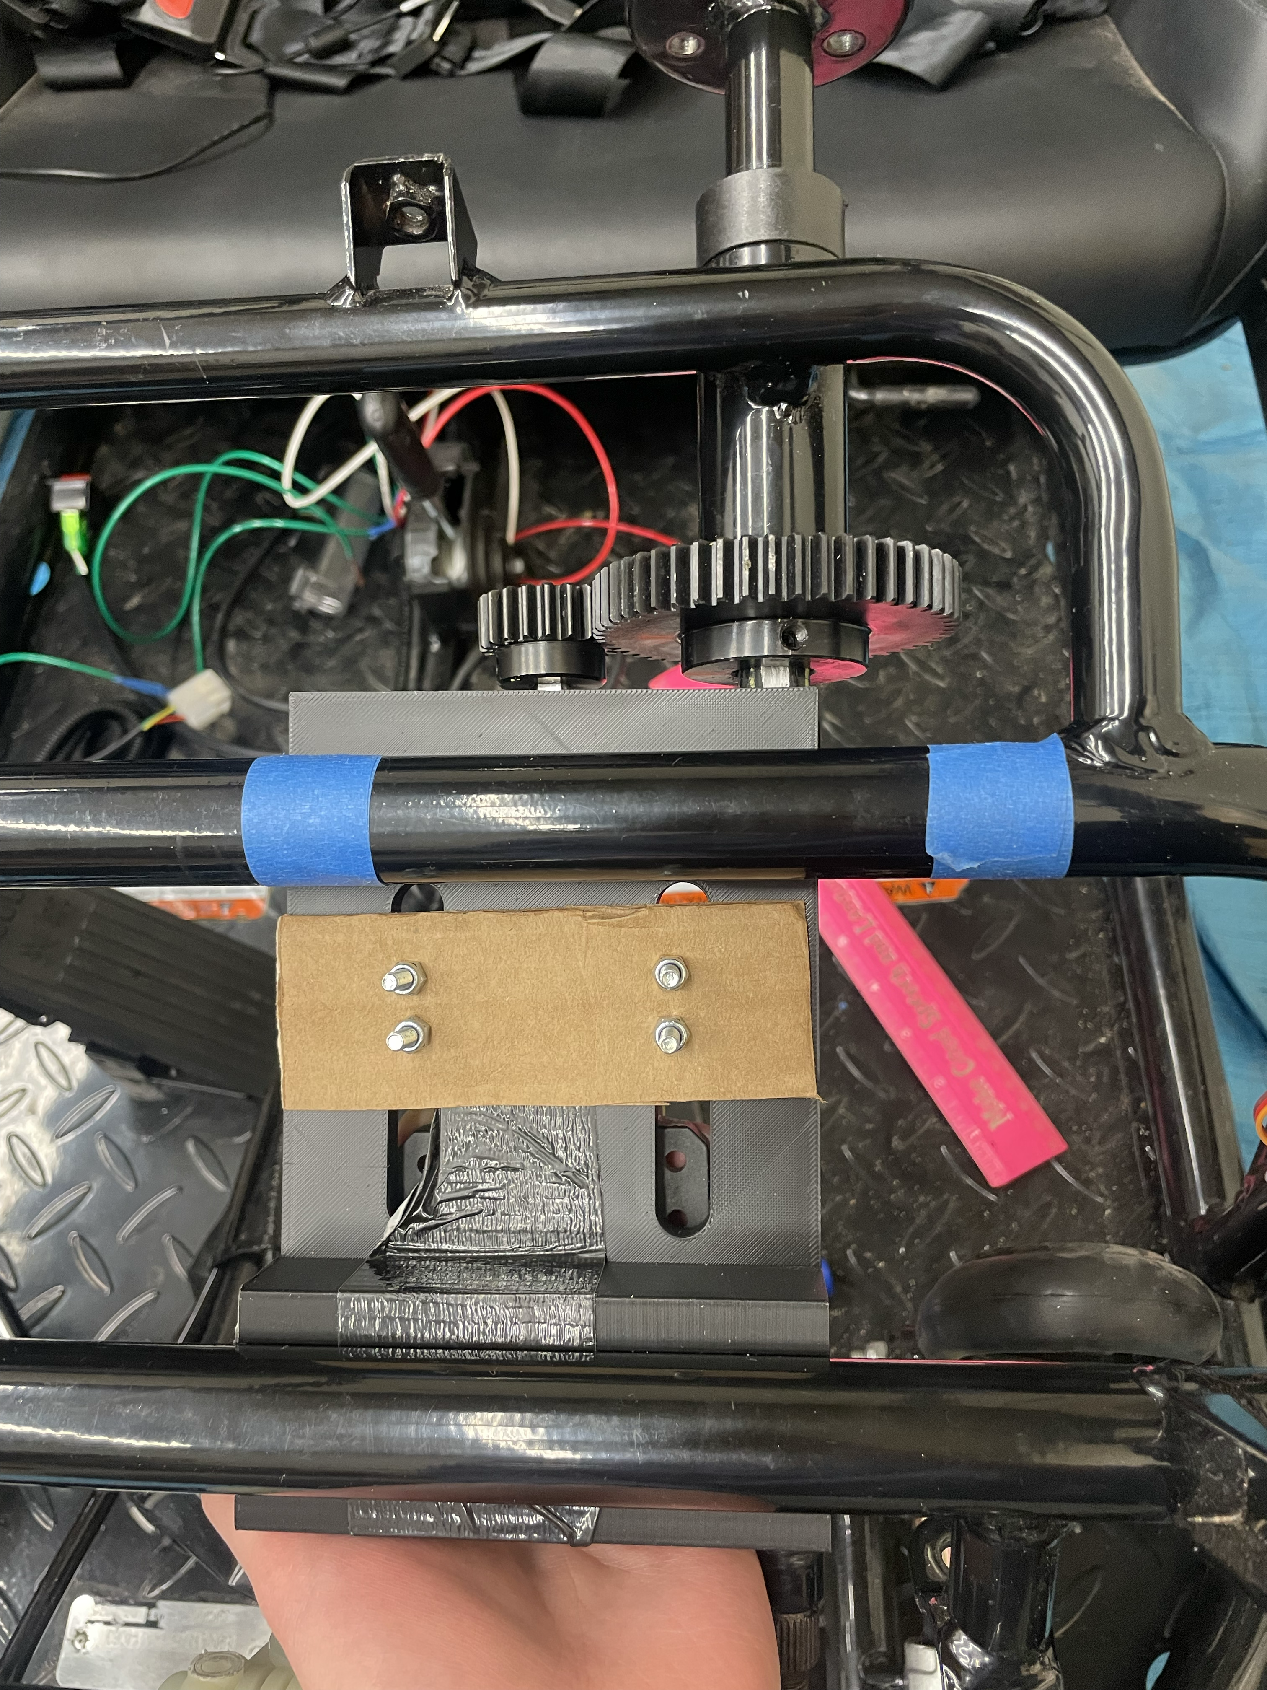
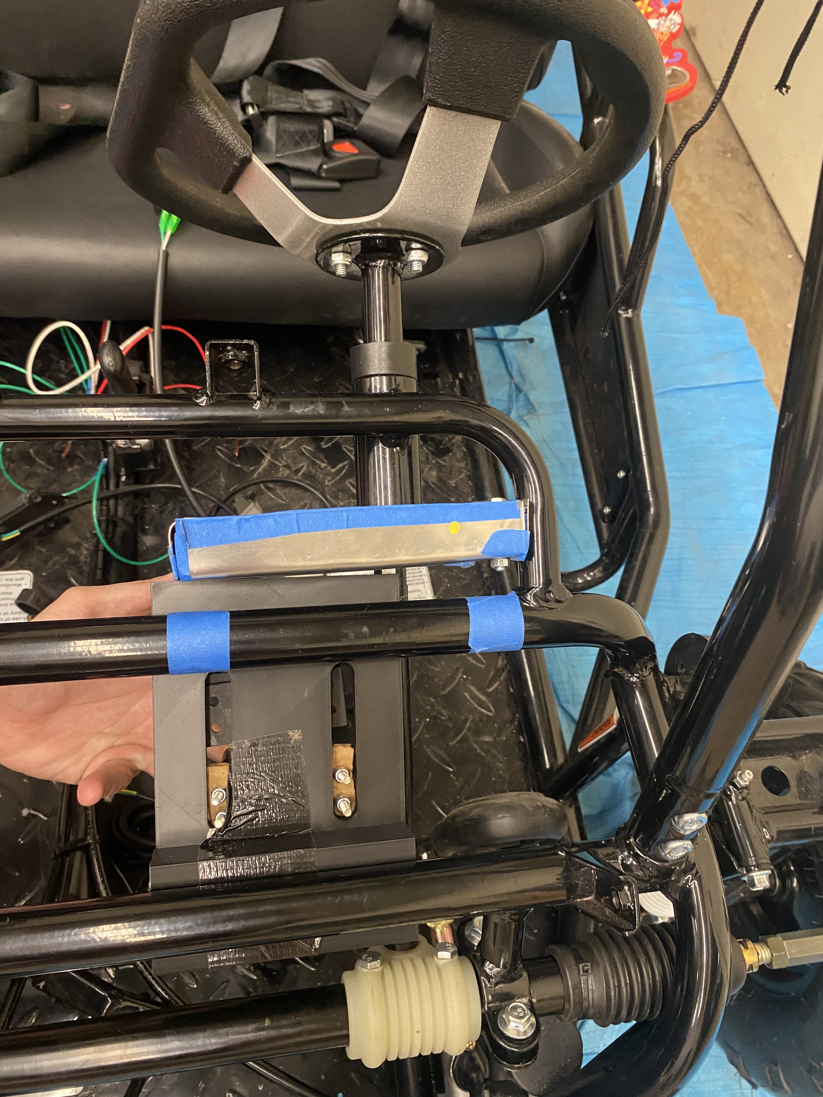
Steering
DM 20

Slide 23
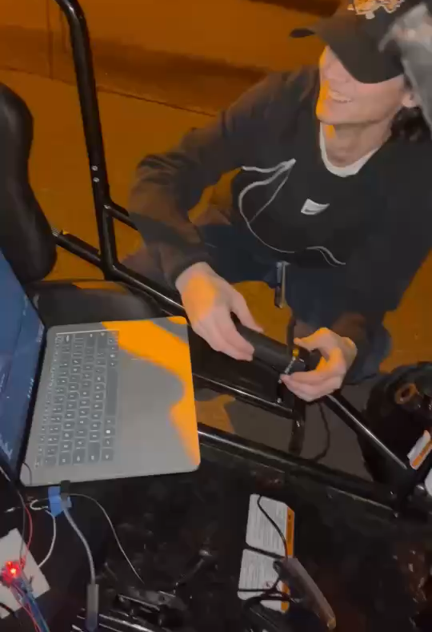
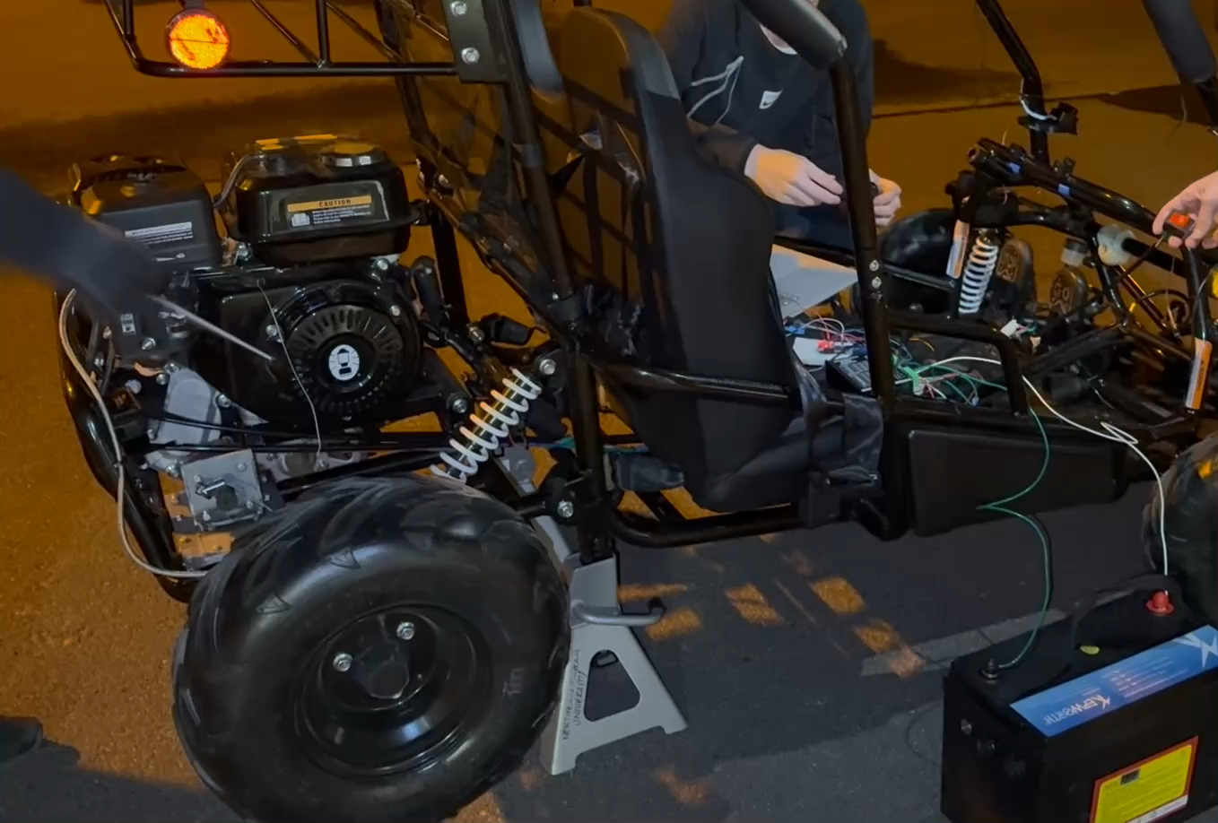
Throttle Demo
NP 21

Slide 24
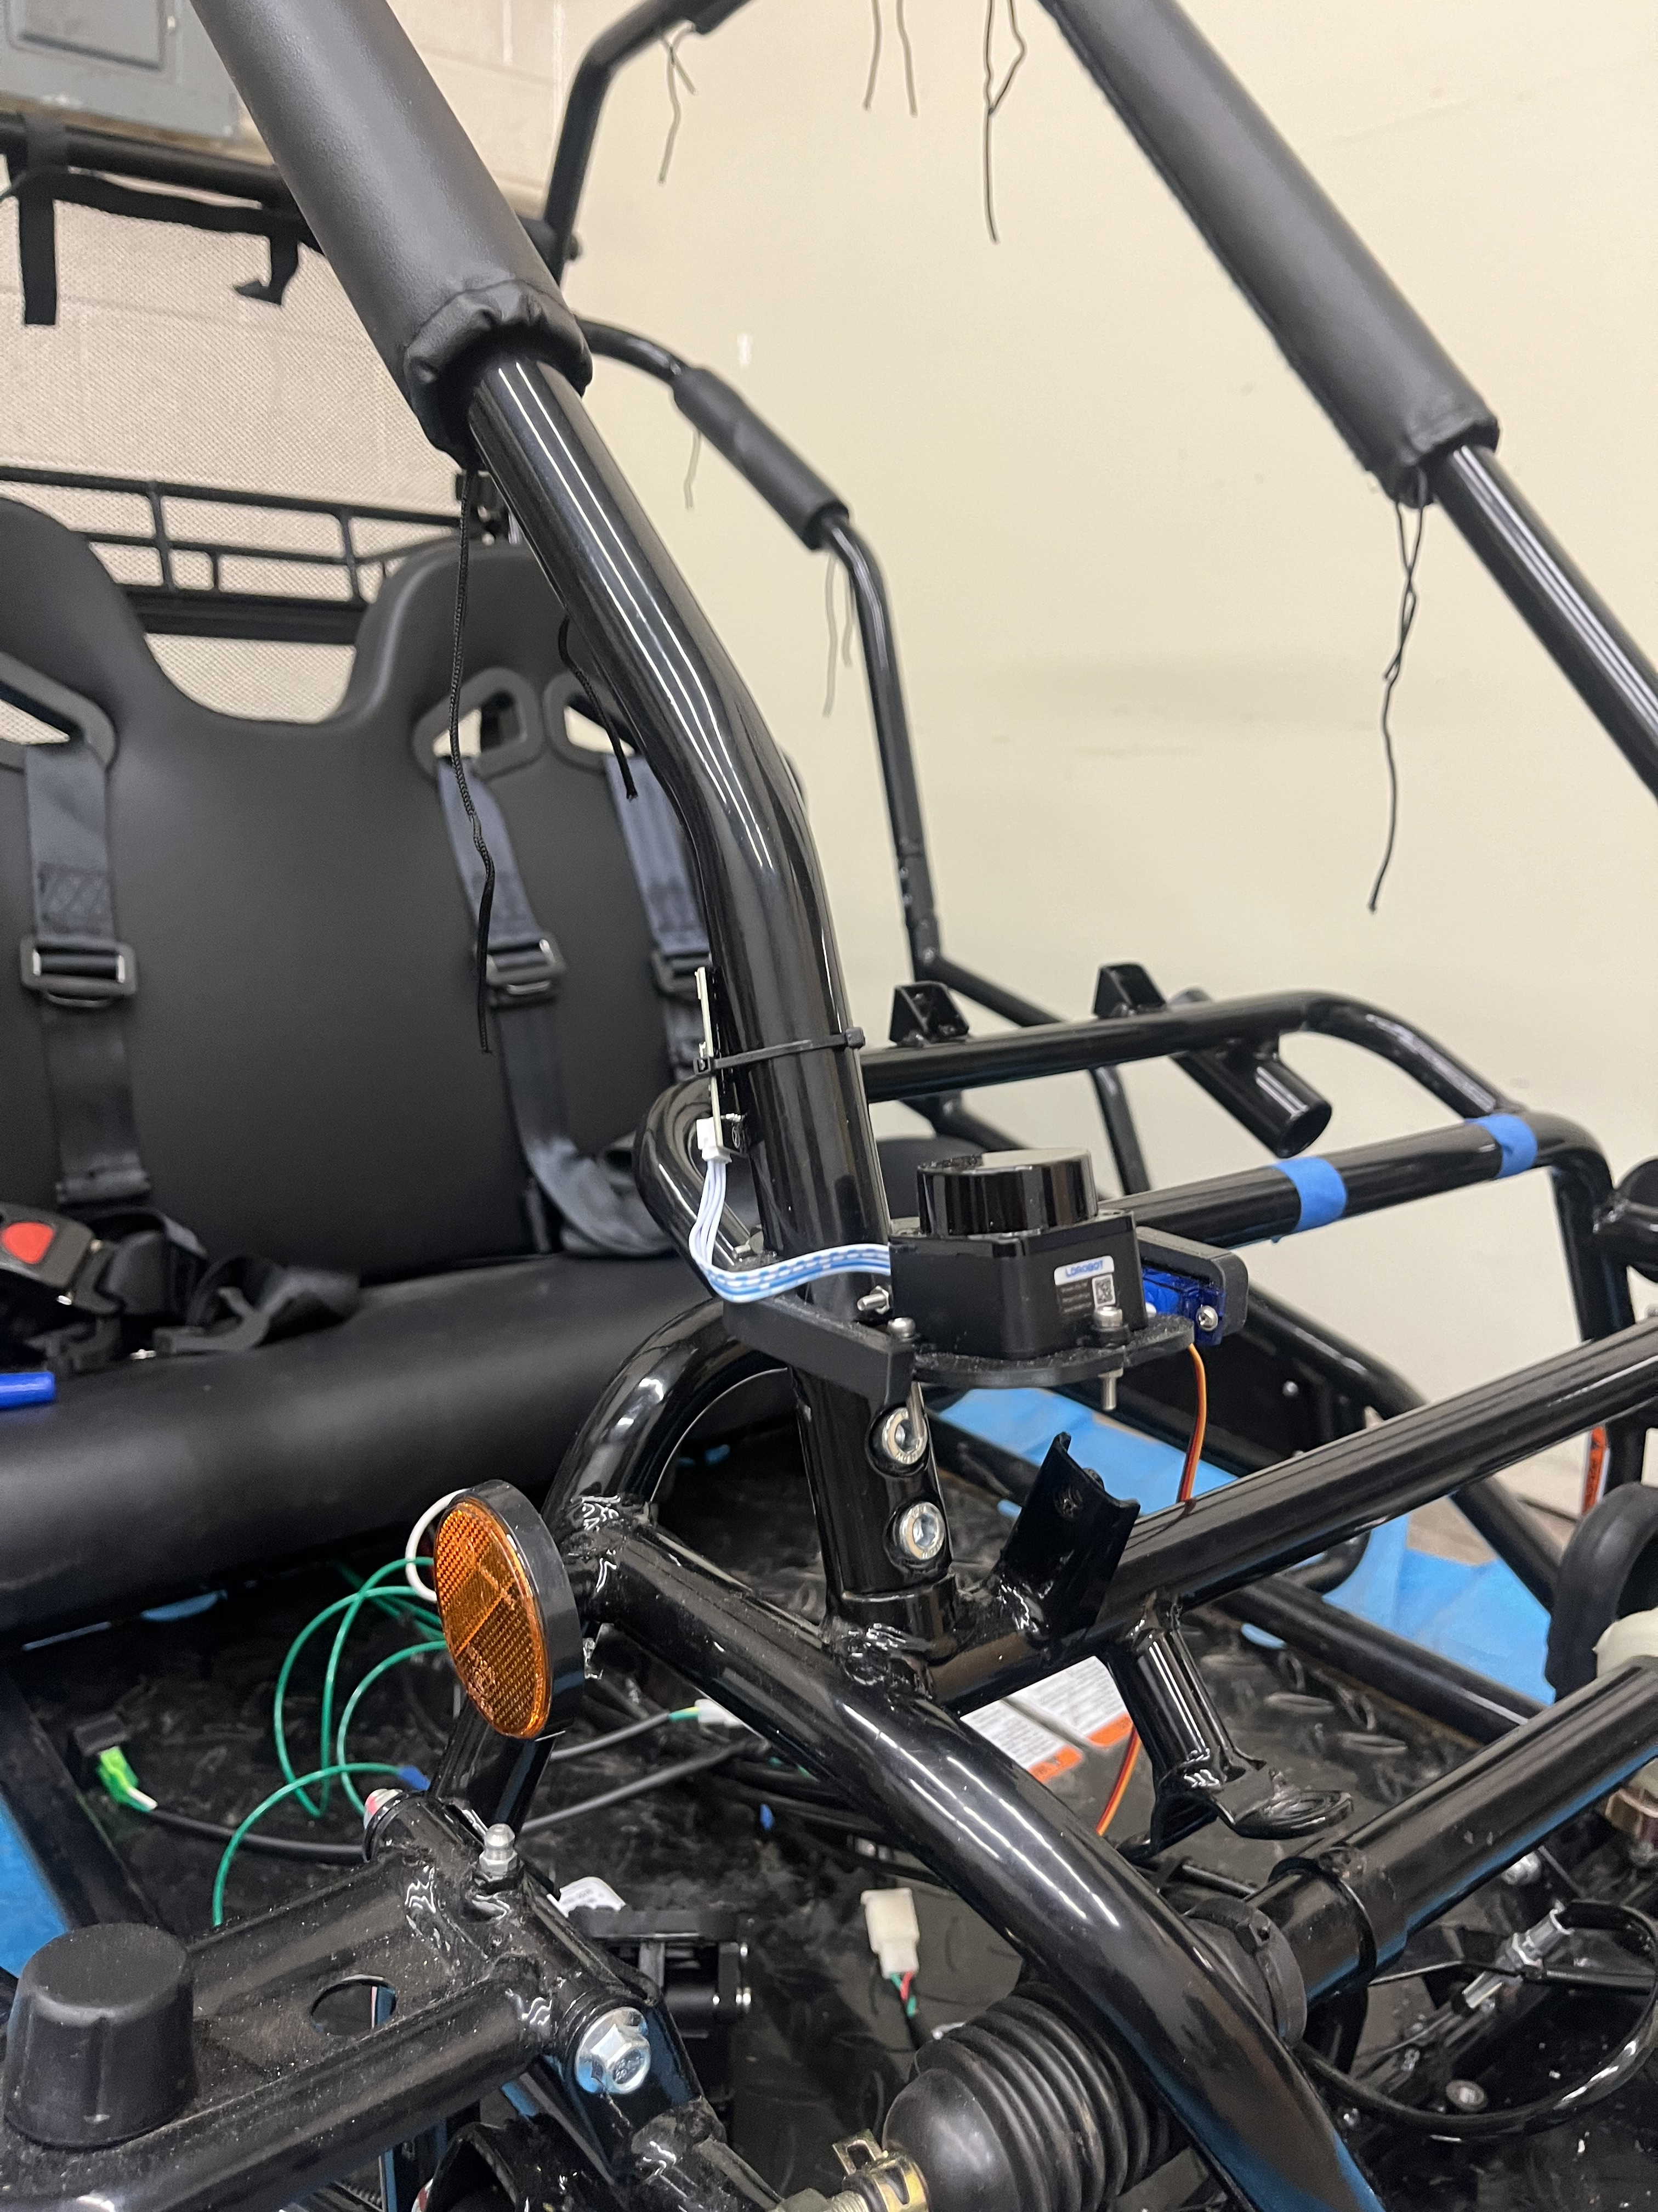
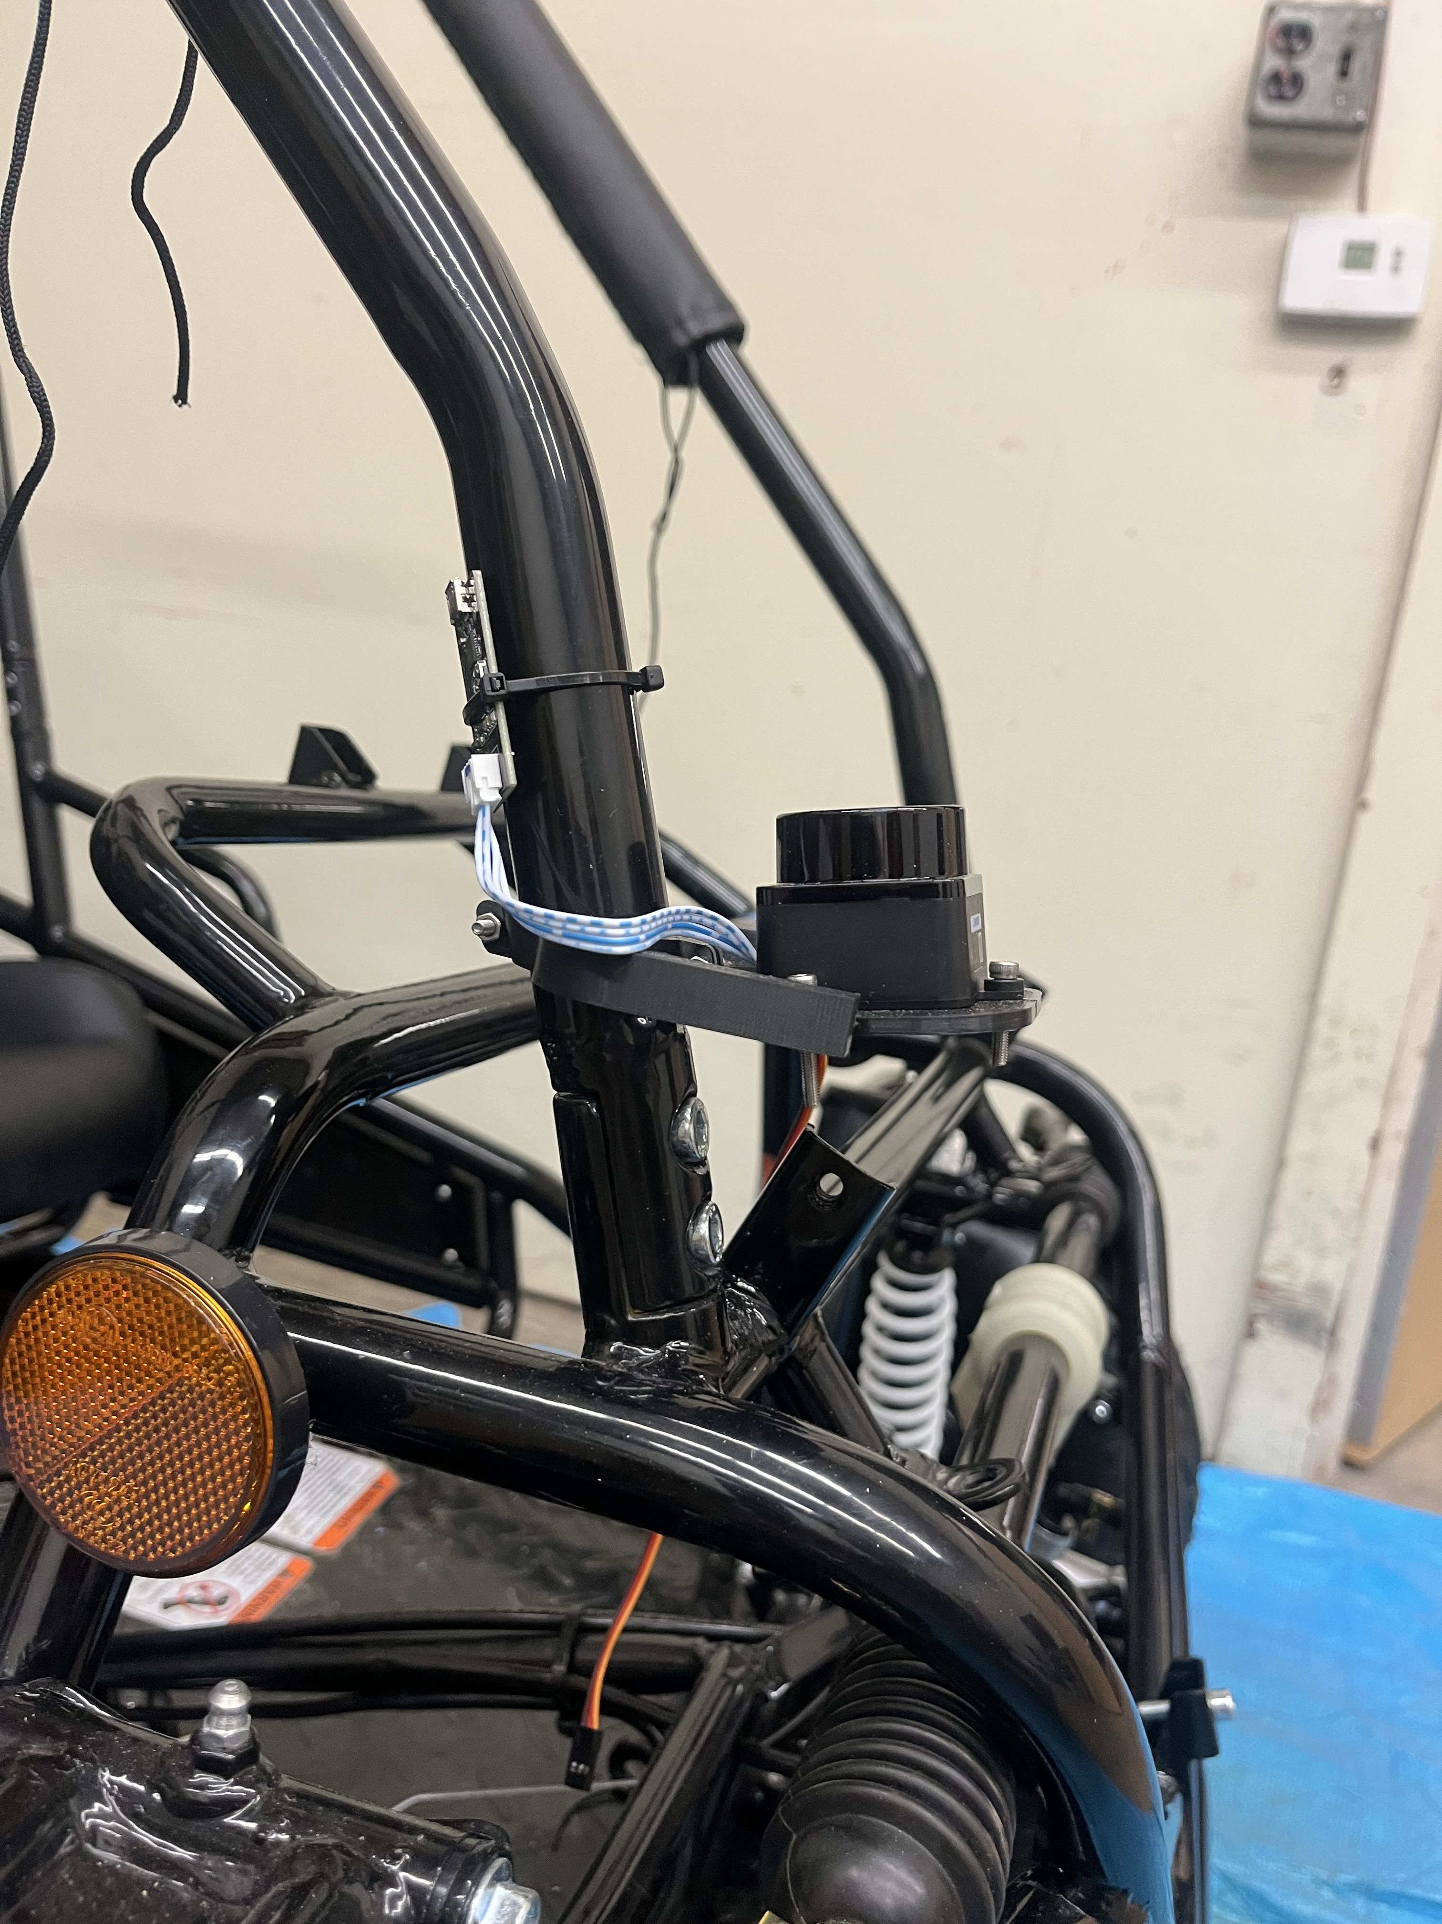
Electrical Mounts
LiDAR Sensor
LiDAR Mount

Slide 25
Gantt Charts

Slide 26
Brakes
 |  |  |  |  |  |  | 12-Jan | 19-Jan | 26-Jan | 2-Feb | 9-Feb | 16-Feb | 23-Feb | 2-Mar | 9-Mar | 16-Mar | 23-Mar | 30-Mar | 6-Apr | 13-Apr | 20-Apr | 27-Apr
Task | Project Lead/s | Start Date | End Date | Days | Estimated Hours | Actual Hours | Wk 1 | Wk 2 | Wk 3 | Wk 4 | Wk 5 | Wk 6 | Wk 7 | Wk 8 | Wk 9 | Wk 10 | Wk 11 | Wk 12 | Wk 13 | Wk 14 | Wk 15 | Wk 16
Project Management | Everyone | 12-Jan | 18-Jan | 6 | 6 | 8
CAD Packet Rework | Jacob,Marek | 13-Jan | 20-Jan | 7 | 20 | 25
Engineering Calculations | Jacob,Marek | 18-Jan | 25-Jan | 7 | 10 | 16
First Test | Everyone | 25-Jan | 9-Feb | 15 | 25
Boeing Demo | Everyone | 10-Feb | 17-Apr | 66 | 120
33% Progress | Jacob,Marek | 12-Jan | 3-Feb | 22 | 30 | 34
67% Progress | Jacob,Marek | 12-Jan | 26-Feb | 45 | 60
100% Progress | Jacob,Marek | 12-Jan | 25-Mar | 72 | 90
ML 23

Slide 27
Steering
 |  |  | Week
Task | Start Date | End Date | 1 | 2 | 3 | 4 | 5 | 6 | 7 | 8 | 9 | 10 | 11 | 12 | 13 | 14 | 15
Final CAD | 12-Jan | 20-Jan
Motor Testing | 20-Jan | 30-Jan
Gearbox Manufacturing | 20-Jan | 2-Feb
Gear Mounting | 20-Jan | 2-Feb
Motor Mount Manufacturing | 20-Jan | 15-Feb
Motor and Gearbox Mounting | 15-Feb | 22-Feb
Testing Gears with Motor | 15-Feb | 1-Mar
Initial Testing with Entire System | 1-Mar | 15-Mar
Finalizations | 16-Mar | 30-Mar
LQ 24

Slide 28
Throttle
 |  |  |  |  |  | Week
Throttle Subsystem | Start Date | End Date | Days | Estimated Hours | Actual Hours | 1 | 2 | 3 | 4 | 5 | 6 | 7 | 8 | 9 | 10 | 11 | 12 | 13 | 14 | 15
Project Summary and Management | 12-Jan | 19-Jan | 7 | 15 | 18
Redesign of Stepper Mount | 20-Jan | 24-Jan | 4 | 8 | 8
Mounting Stepper Mechanism | 25-Jan | 29-Jan | 5 | 12 | 15
Testing Stepper Mechanism (33% Progress) | 30-Jan | 01-Feb | 3 | 6 | 8
Designing Mount for Hand Accelerator | 04-Feb | 10-Feb | 6 | 10
Test Hand Accelerator | 12-Feb | 14-Feb | 3 | 6
Improve Base Plate and C-Clamps for Stepper Mount | 15-Feb | 20-Feb | 5 | 14
Improve Spring Strength in Throttle Lever (66% Progress) | 21-Feb | 24-Feb | 3 | 6
Re-Manufacture Spool using Metal | 25-Feb | 04-Mar | 7 | 15
Testing and Improving all Components | 16-Mar | 27-Mar | 14 | 30
NP 25

Slide 29
Thank you!
Questions?

Slide 30
References
[1] E. Oberg and C. J. Mccauley, Machinery’s handbook : a reference book for the mechanical engineer, designer, manufacturing engineer, draftsman, toolmaker, and machinist. New York: Industrial Press, 2012.
[2] J. H. Jung, N. Pan, and T. J. Kang, “Capstan equation including bending rigidity and non-linear frictional behavior,” Mechanism and Machine Theory, vol. 43, no. 6, pp. 661–675, Jun. 2008, doi: https://doi.org/10.1016/j.mechmachtheory.2007.06.002.
‌
[3] R. G. Budynas, J Keith Nisbett, and Joseph Edward Shigley, Shigley’s mechanical engineering design, 11th ed. New York, Ny: Mcgraw-Hill Education, 2020.
‌

Slide 31
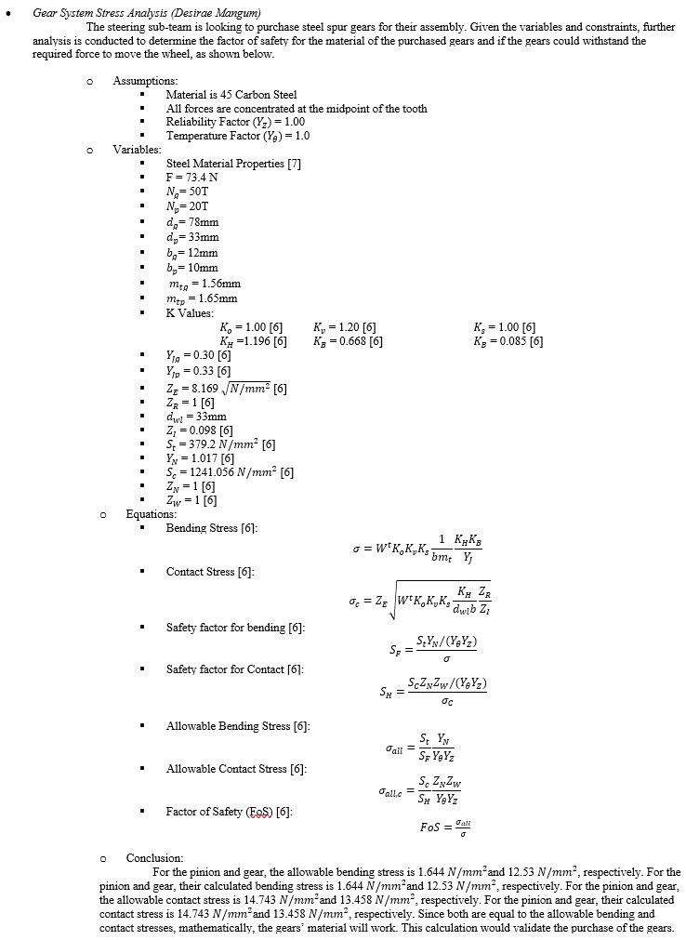
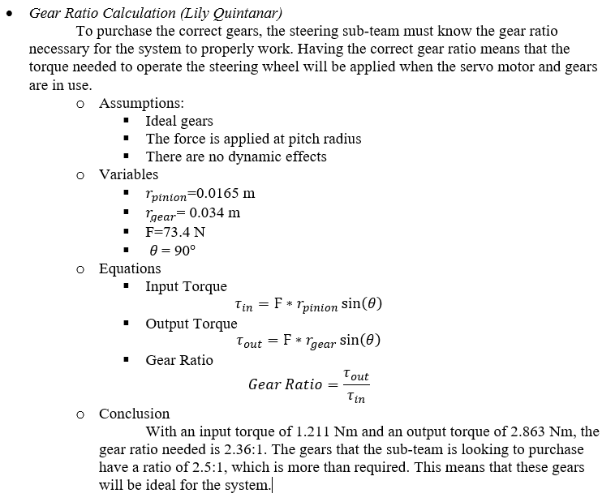
Appendix
Gear System Stress Analysis Hand Calculations
Required Gear Ratio Hand Calculations

Slide 32
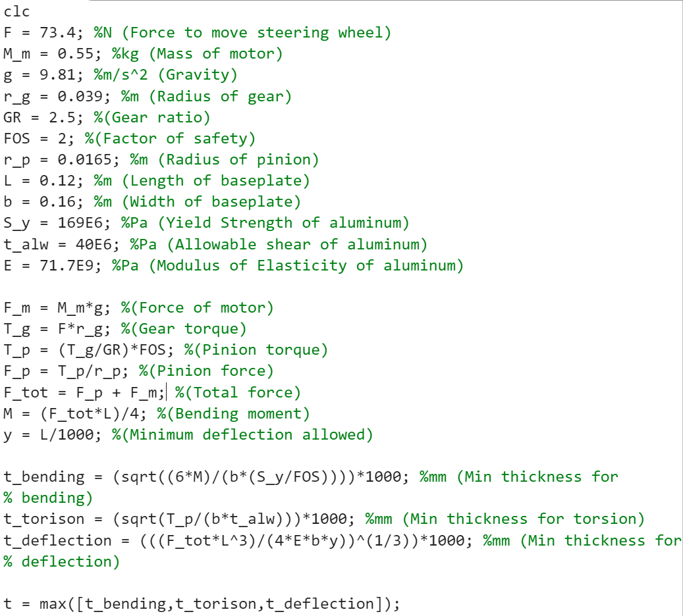
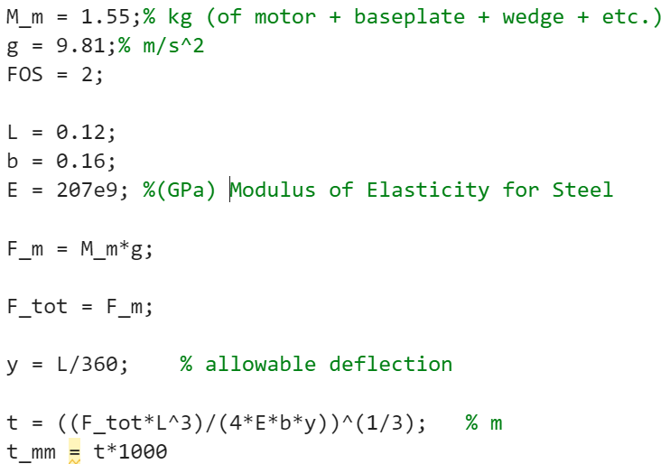
Appendix
Minimum Thickness for Plate
Minimum Thickness for U-Bracket Script

Slide 33
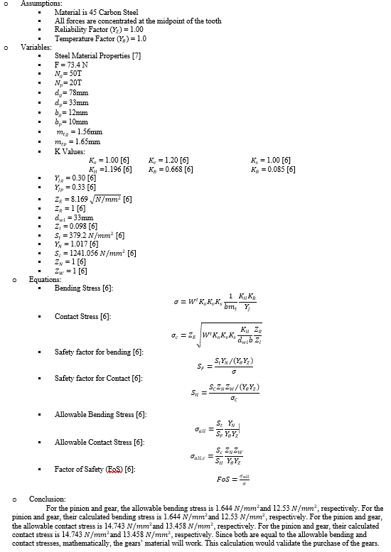
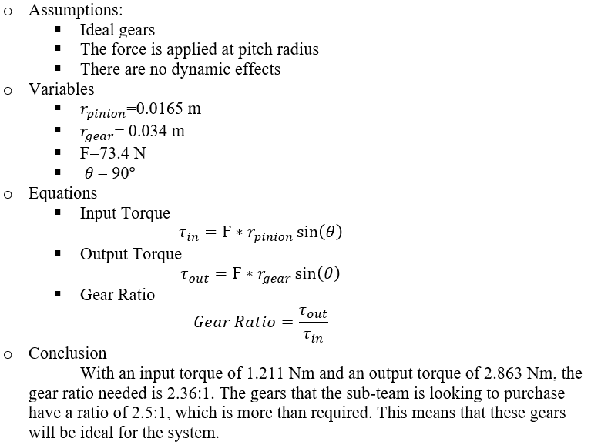
Appendix

